Slide 1
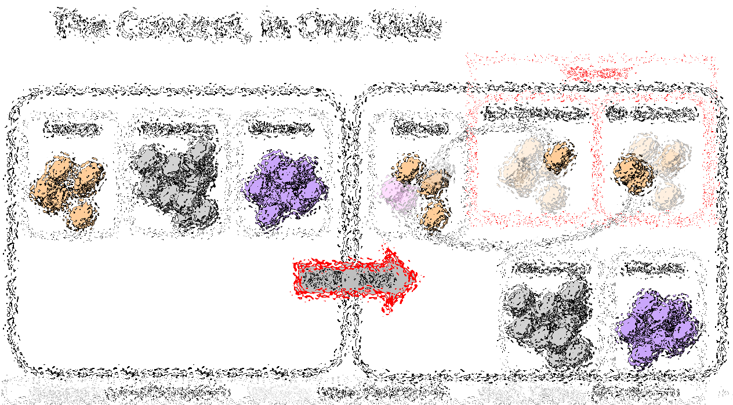
Bip300: How we Police Sidechains Without Looking at Them
Paul Sztorc
Bitcoin++ -- April 29th, 2023
Notes:
TRANSCRIPT OF SPEECH, 11/5/2021: Okay, hello. I’ve been invited to speak about Bip300 ... which is one of my ideas for taking Bitcoin to the next level. ...

Slide 2
Miners
Optimizing: kWh /$ / ASIC Efficiency / Cooling / Labor / Demand Management Programs / Drying Fruit / Getting NatGas Credits / Outcompeting All Rivals
Full Node
Validating L1
+ counting to 13,150
+ add/remove/validate Sidechains

Slide 3
Agenda
Paul Sztorc / LayerTwo Labs
Review: Why BIP 300
An Example – zCash
The BIP Text – The Six Messages of BIP 300
Theory: How to Police a [Chain] We Can’t See
Q&A

Slide 4
Paul’s 1000+ Pages About Bitcoin

Slide 5
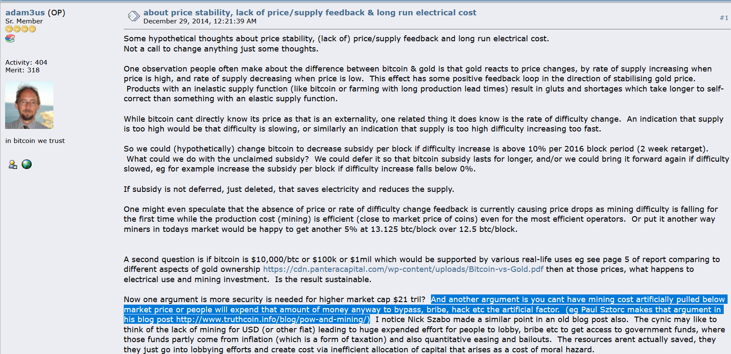
My Big Break
Adam Back links to my blog – Dec 2014

Slide 6
Since Then
Wrote “Truthcoin” whitepaper (decentralized oracle)
Technical Talks
Scaling Bitcoin 1 2 & 3 -- Program Committee for #4
TabConf every year – keynoted in 2018
Bitcoin Wednesday – all around the globe (Toronto, Chicago, Amsterdam, etc)
BitDevs – Summer 2014 (NYC), Austin (May 2018)
Consensus Construct (2017, 2019); American Banker ; Qcon London (2017)
Bitcoin Miami 2019/2021/2022/2023 & Amsterdam
Wrote BIPs 300 and 301.
Countless Podcasts
Financially Stable ....and therefore loyal to Nobody!! Bwahaha!!
(My loyalty is to Bitcoin only.)

Slide 7
Part 2 – Why Bip300
My Three Favorite Endorsements
"Drivechains…are pretty cool…and arguably could have been more important or useful than let’s say Taproot.“ - Adam Back, Baltic Honeybadger 2022, Live on stage in front of everyone
“We need Drivechain or all the work of thousands in the last 13 years will be in vain.” ... “Drivechain is our only hope”. - fiatjaf, (creator of nostr), on twitter
“We need your project, of course, for the obvious reasons...” - Rene Pickhardt ( Author of Mastering Lightning , #1 stackoverflow (?) contributor for LN questions ), MIT Bitcoin Expo, 2023
Visit www.LayerTwoLabs.com/friends for 47 more!
Notes:
These people all *Lead* a different project. Adam Back leads Blockstream and thus indirectly Liquid. Fiatjaf leads nostr. Rene is one of the leaders of LN.
Yet they all found some nice things to say about my project.
What can I say, kids – real respects real.

Slide 8
A Bold Claim
BIP300 Solves All of Bitcoin’s Biggest Problems
Heterogeneity Problem
Scalability
Privacy
Scams – Eliminating ScamCoins ; Domesticating the Token Casino
Security Budget
Decentralization
“Fundamental Value” of Bitcoin
With...
...zero risk to Bitcoin!

Slide 9
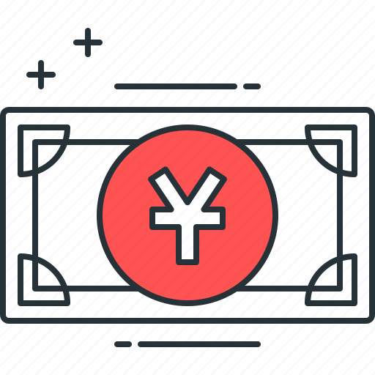
BIP300: Everything on Top of Bitcoin
zCash
FileCoin
ETH
VISA
WeChat Pay
ETH
zCash
FileCoin
BTC Today
WeChat Pay
VISA
BTC + Drivechain
Today ☹
Tomorrow ☺
Notes:
What is BIP300 about ??

Slide 10
BIP300: Everything on Top of Bitcoin
zCash
FileCoin
ETH
VISA
WeChat Pay
ETH
zCash
FileCoin
BTC Today
WeChat Pay
VISA
BTC + Drivechain
Today ☹
Tomorrow ☺
Notes:
6

Slide 11
The Coming Death of Bitcoin’s Competitors
WeChat Pay
VISA
ETH
BTC Today
zCash
BTC + Drivechain
FileCoin

Slide 12
Drivechain = Altcoin Tech, BTC Coin Only
“Drivechains”
n
n
Bit-Ethereum
Bit-Monero
Bitcoin
Ethereum
Monero
Bitcoin
Bip300
Bip300
BIP 300
Ethereum
Monero
Notes:
Bip300 proposes these new layer2s, that some call “sidechains”. Sidechains are a response to the threat of Altcoins, but they’re also a response to the desire of Bitcoiners for creativity, and innovation – -- you know: the desire to try new things without asking for anyone’s permission. How can we let everyone try the ideas that they like? And how do I keep other people’s bad ideas away from me? So here you see we have the world of Altcoins on the left, but then, the revenge of Bip300 on the right. We have copied Ethereum and Monero into our own projects that respect the 21M coin limit of BTC. No inflation.

Slide 13
A Bold Claim
BIP300 Solves All of Bitcoin’s Biggest Problems
Heterogeneity Problem
Scalability
Privacy
Scams – Eliminating ScamCoins ; Domesticating the Token Casino
Security Budget
Decentralization
“Fundamental Value” of Bitcoin
With...
...zero risk to Bitcoin!

Slide 14
A. Heterogeneity
Smart Contracts DeFi Turing Completeness Ring Signatures zk-Snarks Large Blocksizes
NFTs Oracles
Mimblewimble
…(etc)
Bitcoin does seem great… but can it do _______ ?
Actually we DON’T want Bitcoin to do ______ in the first place because it is actually a bad due to _______, as you can read ______. But if by ______ you really mean ______, then yes Bitcoin can do that! Eventually we are working on _____ which should be able to do ______ even better than ______ anyway but it is actually a good thing that the protocol is so difficult to upgrade beca …
Yes. See BIP 300.
Noob
Bitcoiner
Notes:
Ideally, with Bip300, if some annoying person asks “Sure Bitcoin seems great, but can it do .... smart_contracts, DeFI, zk-snarks, blah blah, you just say “Yes, Bitcoin can do that – see Bip300”.

Slide 15
A. Heterogeneity
I can improve Bitcoin! It only needs my new idea: _______ !! When can you merge my code ??
You can’t just merge something into Bitcoin -- It affects everyone else’s nodes!! Besides, ______ has been proposed before and you need to read ______ so that you can learn why everyone hates it, especially our infallible _______ who would have done it by now if it were a good idea. ________ is a SCAM and you are trying to ATTACK BITCOIN!! Even if your idea was good it would probably take years to get consensus and get merged into …
Noob (and/or Fringe Genius)
Use BIP 300.
Good luck!!
Bitcoiner
Notes:
Similarly, if some innovator dreams up a crazy idea, “Hey I can improve Bitcoin, it only needs my new idea ... larger blocksizes, Turing Completeness, KYC-miner-coins?” Then: similarly, they now can do that without anyone’s permission. They just don’t do it on Bitcoin base layer, they do it on a Bip300 sidechain.
So: that’s the goal – FREEDOM. Developers can write whatever code they want, users can use that code if they like. Everyone gets what they want. But how is it accomplished?

Slide 16
A Bold Claim
Different strokes for different folks.
BIP300 Solves All of Bitcoin’s Biggest Problems
Heterogeneity Problem
Scalability
Privacy
Scams – Eliminating ScamCoins ; Domesticating the Token Casino
Security Budget
Decentralization
“Fundamental Value” of Bitcoin
With...
...zero risk to Bitcoin!
Different chains for different users.
A team of region-specific chains, each with a large growing Blocksize – onboard users directly to L2.
zCash drivechain.
Have a dedicated NFT/ERC/Ordinals chain. Pay all txn fees in BTC. Clear coin roles.
Merged Mining = miners collect ALL fees from ALL chains. For free.
Shrink L1 Bitcoin Core Blocksize, and ossify (the spec at least). No more politics.
Chains are actually useful for real world tasks.
BitNames + Truthcoin ; examples

Slide 17
That “Zero Risk” Part
Bip300 is an easy soft fork to add to Bitcoin... And an easy soft fork to remove.
Bitcoin Core v25
BIP 300 Softfork
New Bitcoin Core
Interoperable with Core v25
A Softfork Banning all Bip300 Deposits/Withdrawals from L1
Bitcoin Core v25
New Bitcoin Core
Interoperable with Core v25
So, worst case scenario, miners just run a simple softfork, and we are exactly back to where we are today.

Slide 18
A Bold Claim
BIP300 Solves All of Bitcoin’s Biggest Problems
Heterogeneity Problem
Scalability
Privacy
Scams – Eliminating ScamCoins ; Domesticating the Token Casino
Security Budget
Decentralization
“Fundamental Value” of Bitcoin
With...
...zero risk to Bitcoin!
Different chains for different users.
A team of region-specific chains, each with a large growing Blocksize – onboard users directly to L2.
zCash drivechain.
Have a dedicated NFT/ERC/Ordinals chain. Pay all txn fees in BTC. Clear coin roles.
Merged Mining = miners collect ALL fees from ALL chains. For free.
Shrink L1 Bitcoin Core Blocksize, and ossify (the spec at least). No more politics.
Chains are actually useful for real world tasks.
BitNames + Truthcoin ; examples
Notes:
We don’t have time for all of these, but in the Q&A perhaps we can get back to them. However, I will go deeper into

Slide 19
Scalability – Comparison to LN
* I assume that an automated hot-wallet is out of the question!
 | Lightning N. | LB Drivechain
Onboard without Layer-1 | No | Yes
Receive Payments while Offline* | No | Yes
Recover Wallet From Seed | No | Yes
Unlimited Liquidity | No | Yes
Option to use SPV Mode | No | Yes
Reckless | Yes | Yes
Txn Settles Instantly | Yes | No
…the primary advantage of LN is fast settlement, especially when both buyer and seller are online. So, LN probably best for in-person retail; DC better for online shopping, perhaps.
Notes:
I have some extra specific

Slide 20
Scalability – Fees
Onboard n users, each makes m payments, stay on L2.
 | Lightning Network | Largeblock Drivechain
Extra Software | LN Node | SC Node (SPV option)
Onboard n Users | n Layer-1 txns | n Layer-2 txn
m Payments | ..on LN | ..on DC
L1 Base Fee | 3*m | 1
L2 Base Fee | 0 | 1 + (n*m)
L2 Routing Fee | n*m | 0
So, LN is only cheaper when there are many low-value payments. Ie, LN is cheaper than BP, for micropayments.
Notes:
This table shows the total amount of fees that a user will have to pay. I have charitably assumed that LN will have no base fee. Currently I think it is one Satoshi. Rene Pickhardt told me it just shouldn’t be there so I assumed it is zero, to help the LN. That is the only way in which LN has cheaper fees. So LN is better for micropayments. Unfortunately, LN also requires you to be able to pull It is the total to onboard m users, have them each make m payments. It does not include settling to L1.

Slide 21
Scalability – Fees
Onboard n users, each makes m payments, stay on L2.
 | Lightning Network | Largeblock Drivechain
Extra Software | LN Node | SC Node (SPV option)
Onboard n Users | n Layer-1 txns | n Layer-2 txn
m Payments | ..on LN | ..on DC
L1 Base Fee | 3*m | 1
L2 Base Fee | 0 | 1 + (n*m)
L2 Routing Fee | n*m | 0
LN’s micropayments require L1 fee-rates to be low, DC’s do not.
Smallest Payment | 90% of L1 $/txn fee | 0% of L1 $/txn fee
Notes:
This table shows the total amount of fees that a user will have to pay. I have charitably assumed that LN will have no base fee. Currently I think it is one Satoshi. Rene Pickhardt told me it just shouldn’t be there so I assumed it is zero, to help the LN. That is the only way in which LN has cheaper fees. So LN is better for micropayments. Unfortunately, LN also requires you to be able to pull It is the total to onboard m users, have them each make m payments. It does not include settling to L1.

Slide 22
LargeBlocks?? What about Decentralization??
Remember: Heterogeneity! People are different! “Coffee txn” does not need as much decentralization as other txns. Bitcoin must compete, today, with Venmo.

Slide 23
Fundamental Value – Namecoin
Namecoin Enables:
One Username – Own a single username, that works everywhere, on every site.
No more passwords! -- Login by being “pinged” with PIN via open protocol.
Easy to keep different online identities separate.
“PayMail” – Special inbox where people must pay you $ in order for the message to go through.
PayMail for introductions + Whitelists = eliminates all spam from the internet. This breaks the chokehold of Google.
On-chain PayMail is completely, 100% untraceable if you run a full node. No TOR required.
Everyone has end-to-end encryption. Everyone has a TOR / i2p website.
No seizing of ICANN domain names.
(Through Bip47 / similar), eliminates the need for Bitcoin addresses.
Notes:
In other words, Satoshi would have an email address, a zCash address, and an Instagram account and a TikTok, automatically.

Slide 24
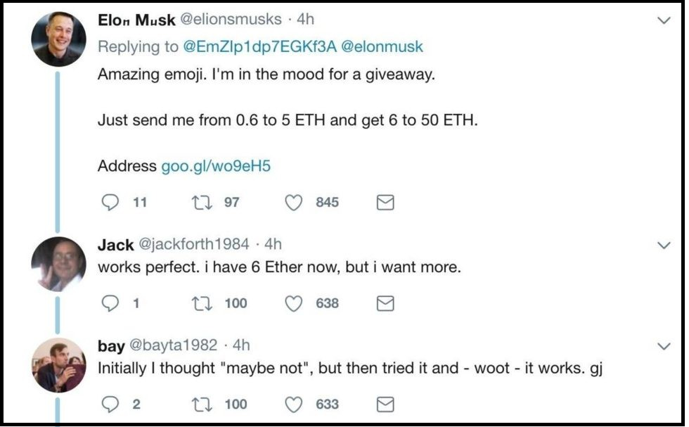
Screenshot #1 from www.truthcoin.info/blog/bitnames/
Notes:
…this is someone pretending to be Elon Musk, on Twitter…

Slide 25
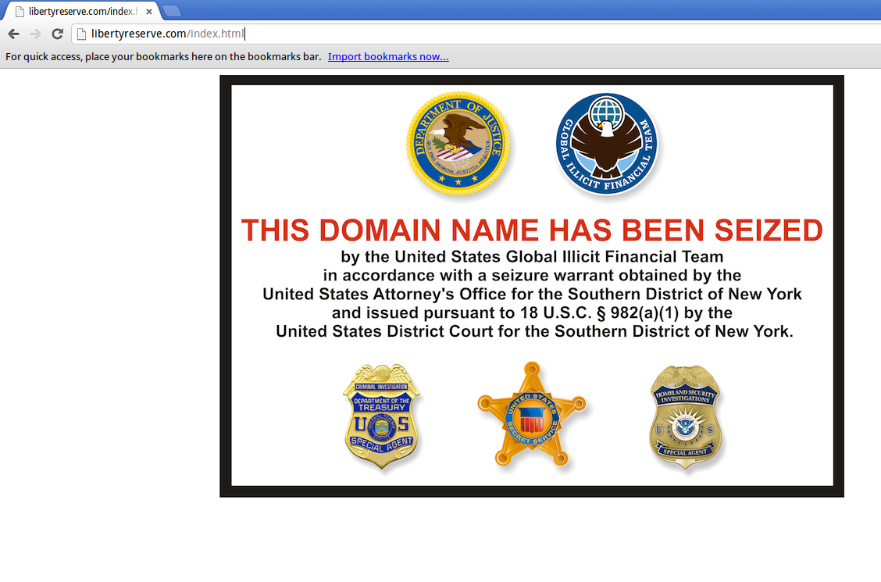
Screenshot #2 from www.truthcoin.info/blog/bitnames/
Notes:
…this is the Liberty Reserve website domain_name being seized…

Slide 26
Screenshot #3 from www.truthcoin.info/blog/bitnames/
Notes:
…this is a guy on YouTube who, in the bottom-right, has to list out all of his screennames ... and they aren’t all identical, his Facebook name is different. With BitDNS everyone would just have one login, for every service. No one could seize your account, anywhere. And people would always be able to find you.

Slide 27
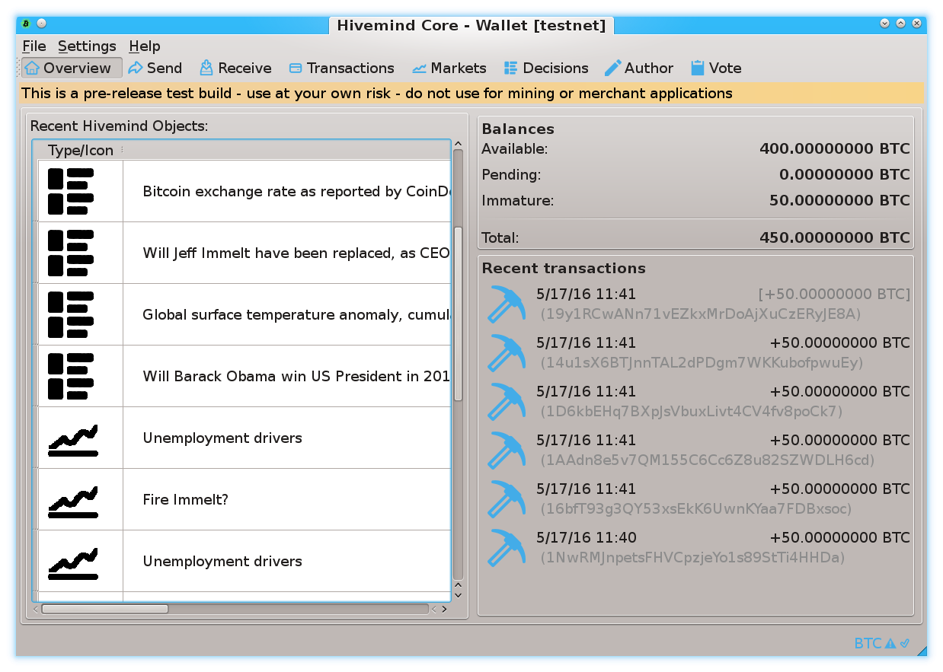
Prediction Markets
Screenshots from my own BTC sidechain project
www.BitcoinHivemind.com
Notes:
This is one of my other projects, BitcoinHivemind.com, check it out. I designed it to be a sidechain from the very beginning. Here are some screenshots…

Slide 28
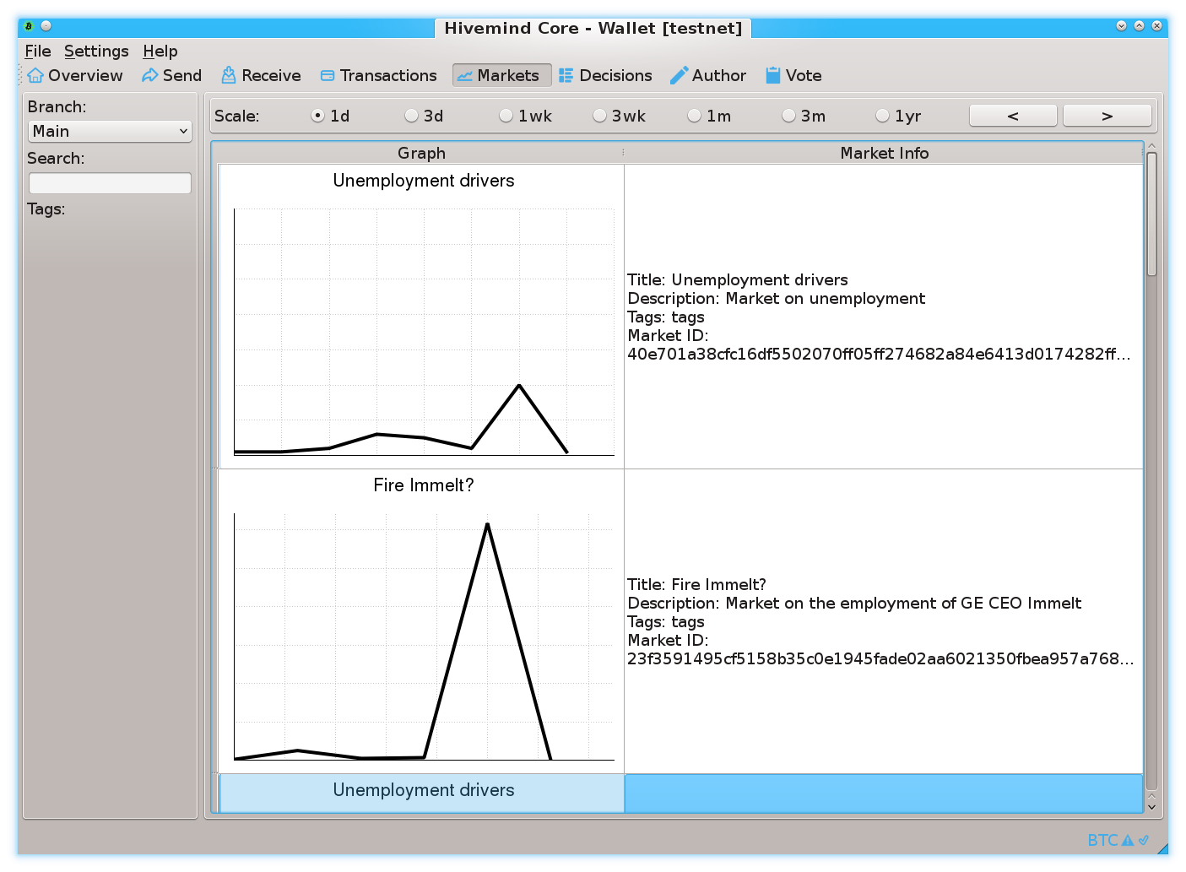
Prediction Markets
Screenshots from my own BTC sidechain project
www.BitcoinHivemind.com
Notes:
…

Slide 29
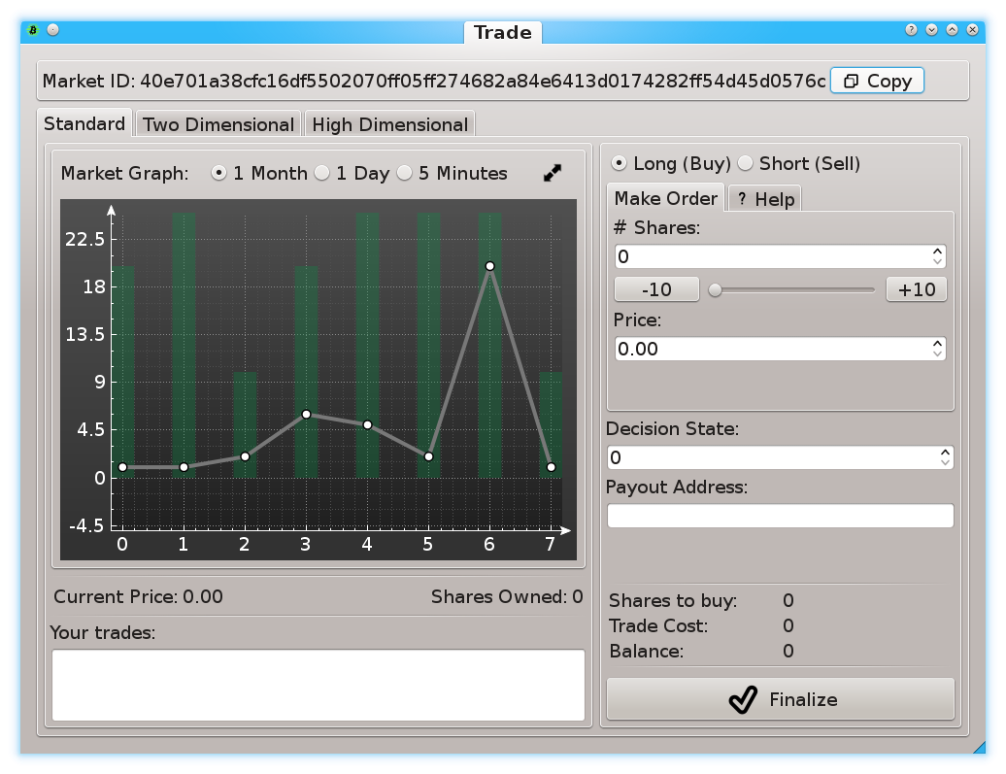
Prediction Markets
Screenshots from my own BTC sidechain project
www.BitcoinHivemind.com
Notes:
… This software can do a lot of things…

Slide 30
Prediction Markets
Screenshots from my own BTC sidechain project
www.BitcoinHivemind.com
Key Idea: “Futarchy” -- futures markets for how well certain leaders would perform, if they were in charge.
Notes:
…but the crowd favorite is ‘Futarchy’ – where there are futures markets for how well certain leaders would perform, if they were in charge. ... This idea is very distressing to bad leaders, [laugh] , because WE can learn about exactly how bad they are going to be, before we cast a vote for anyone. I think that this is one of the most important ideas in the whole world.

Slide 31
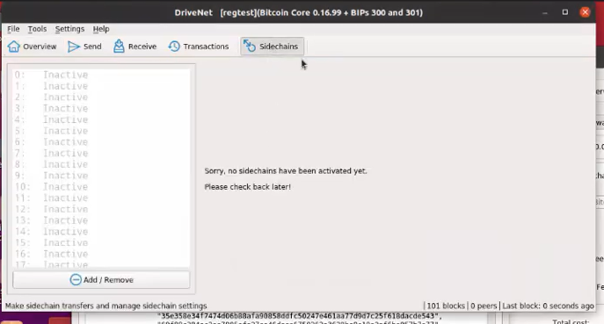
Part 4 – zCash Example
My hope: going through screenshots now, makes it easier to understand the BIP later.
Notes:
Before doing the BIP text, I thought I would just walk you through an example.

Slide 32
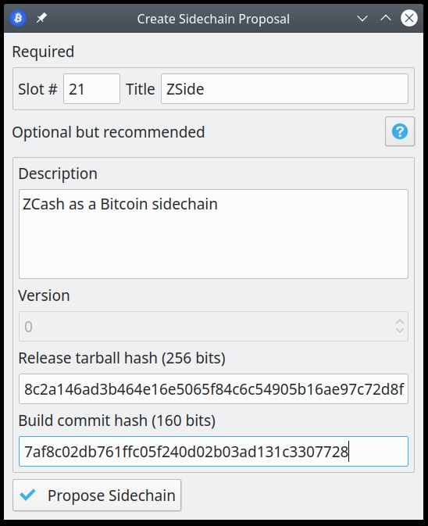
Take a “Slot”
A coinbase message announcing that we want to assign Slot 1:
a global name, and
some optional info to identify the L2 node software

Slide 33
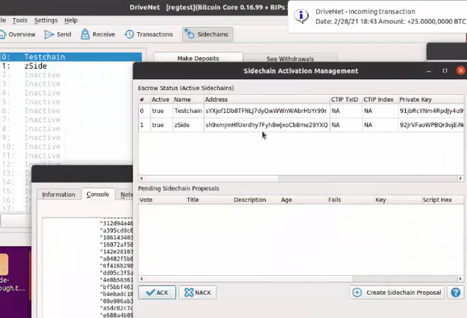
Drivechains are Proposed, and ACKed on L1 Each proposal / Ack is a message in a L1 coinbase txn

Slide 34
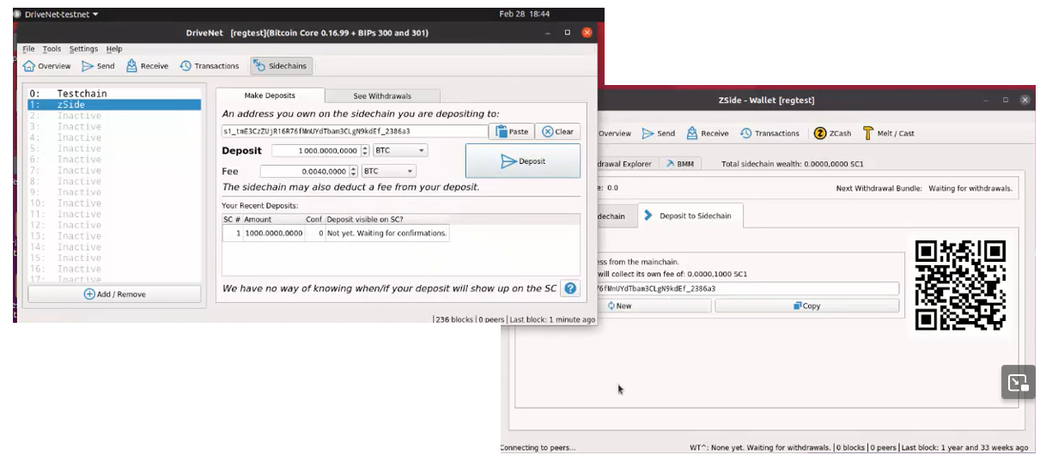
Deposit
1 -- Get destination address from zCash-Drivechain
2 -- Give that to L1
3 -- L1 broadcasts the deposit
4 -- After the deposit confirms on L1, L2 credits user the coins.

Slide 35
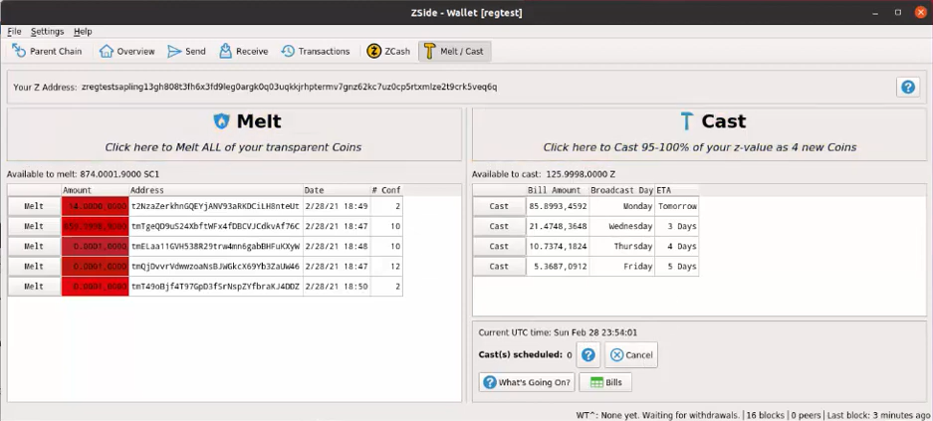
zCash Features
Now we have a z-address to use!

Slide 36
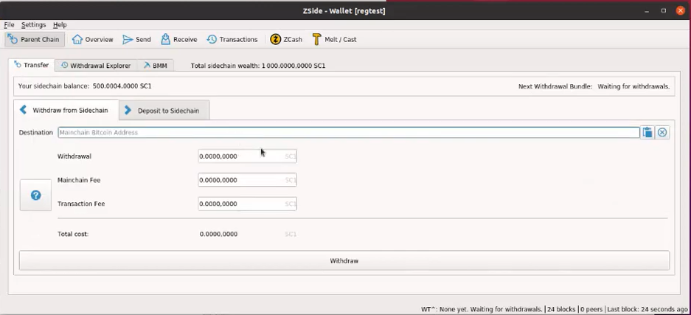
Withdrawing Bit-Zcash to Layer1 BTC

Slide 38
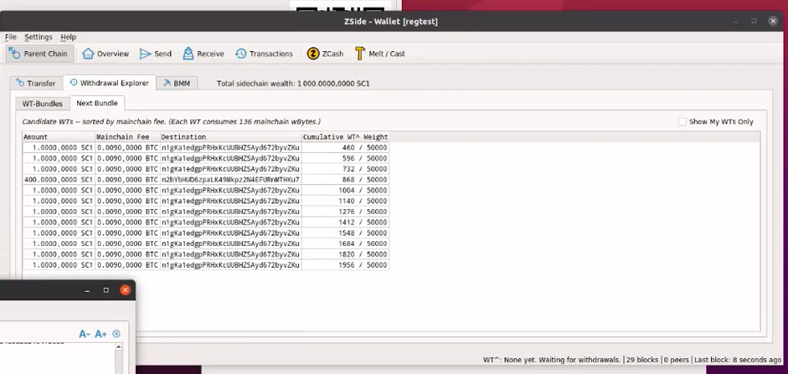

Slide 39
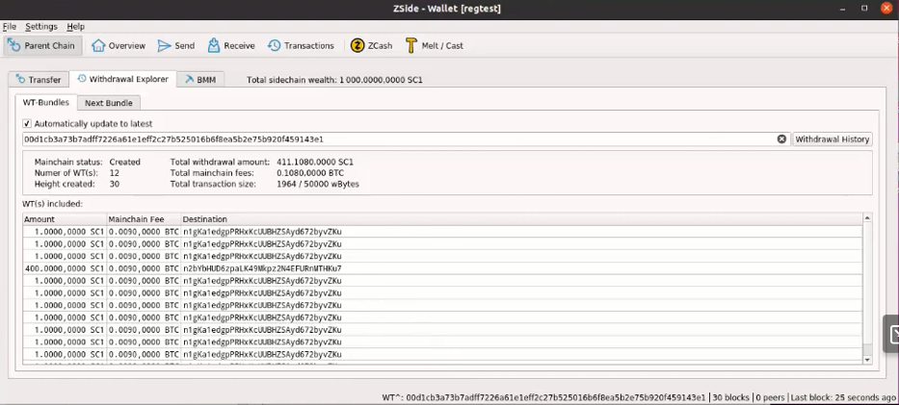

Slide 40
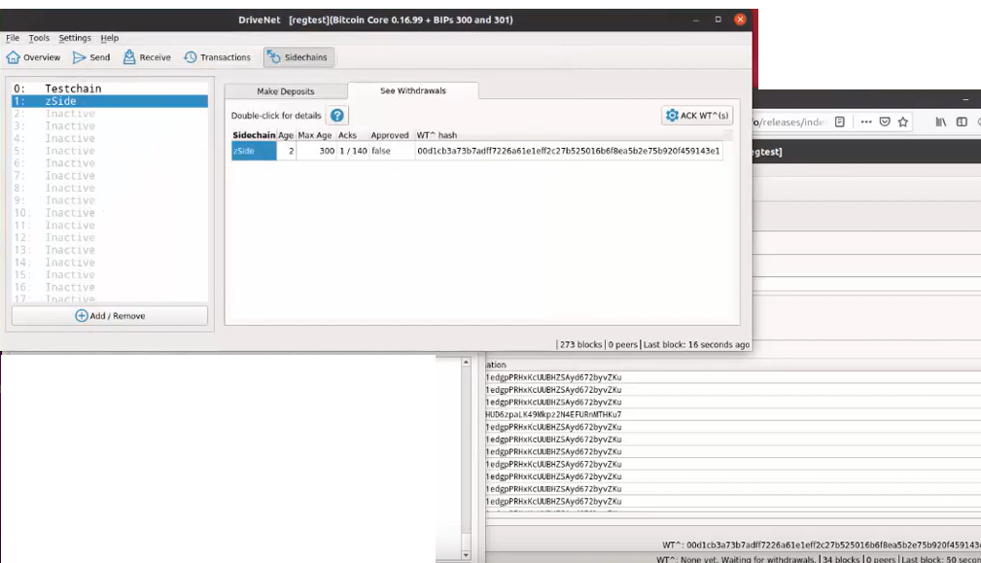

Slide 41
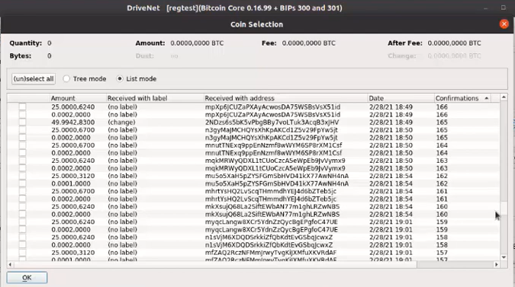

Slide 42
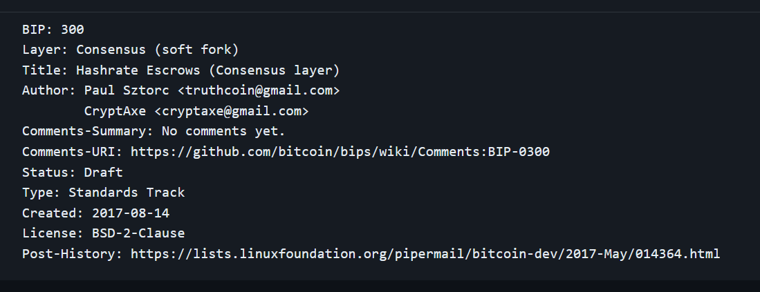
BIP300 – The Six Messages

Slide 43
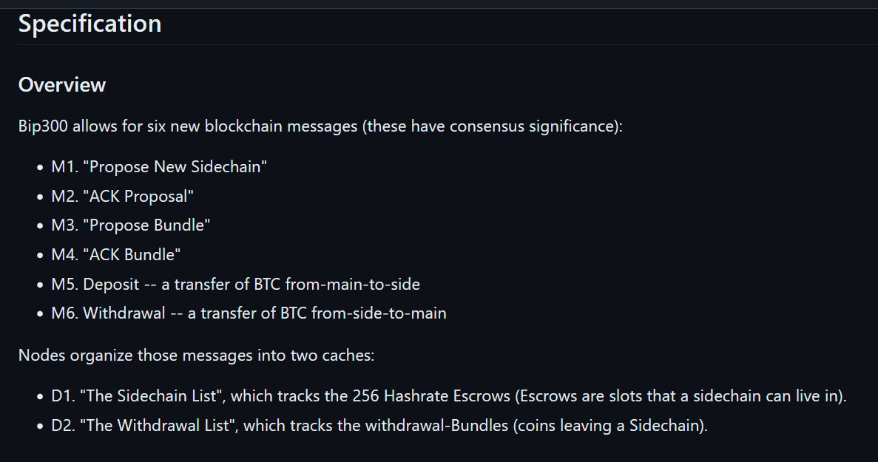

Slide 44
M1

Slide 46
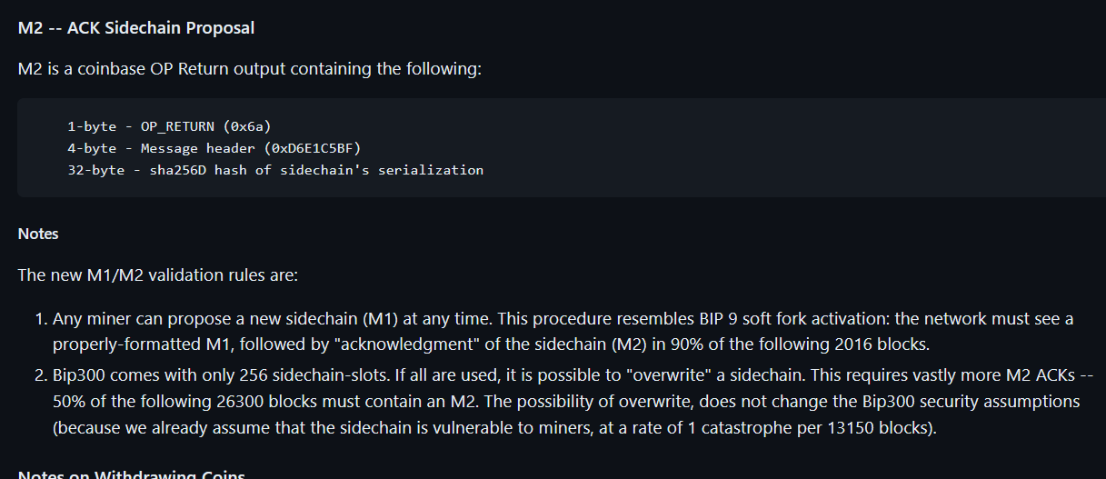
M2

Slide 47
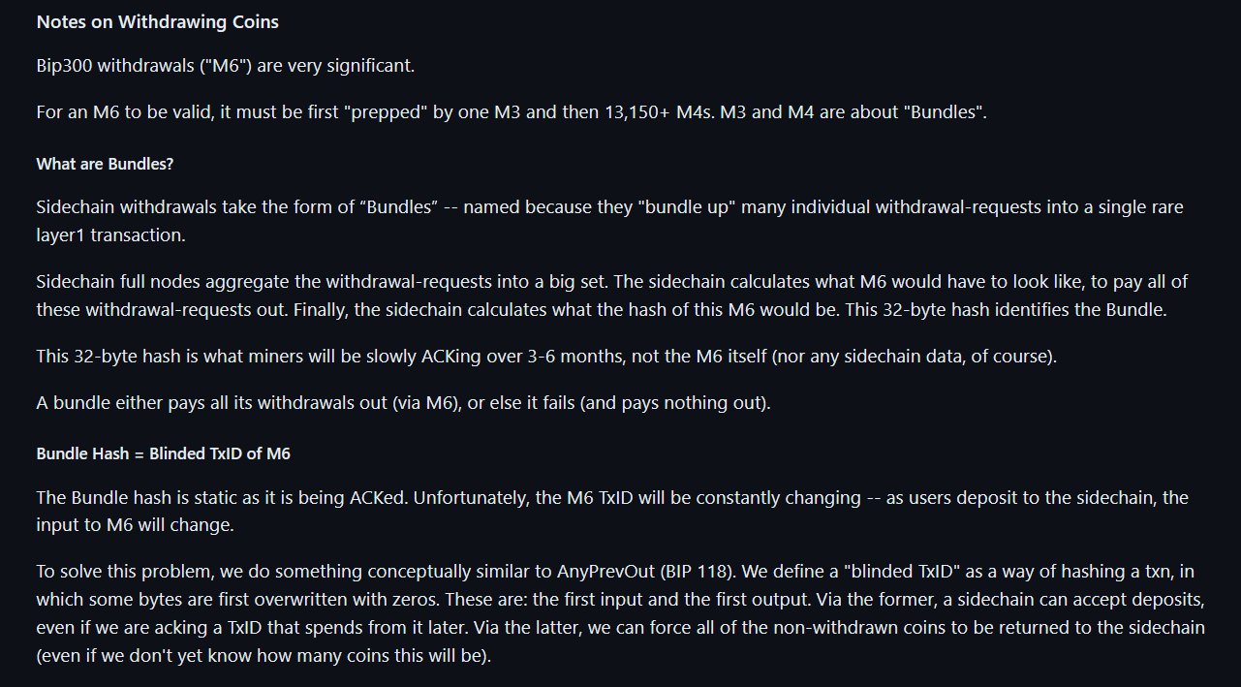
In Drivechain, “Bundles” are very important!

Slide 48
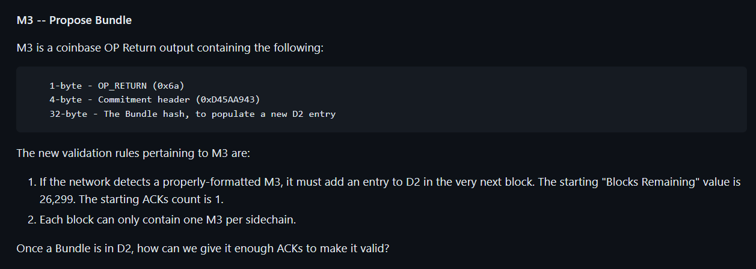
M3

Slide 49
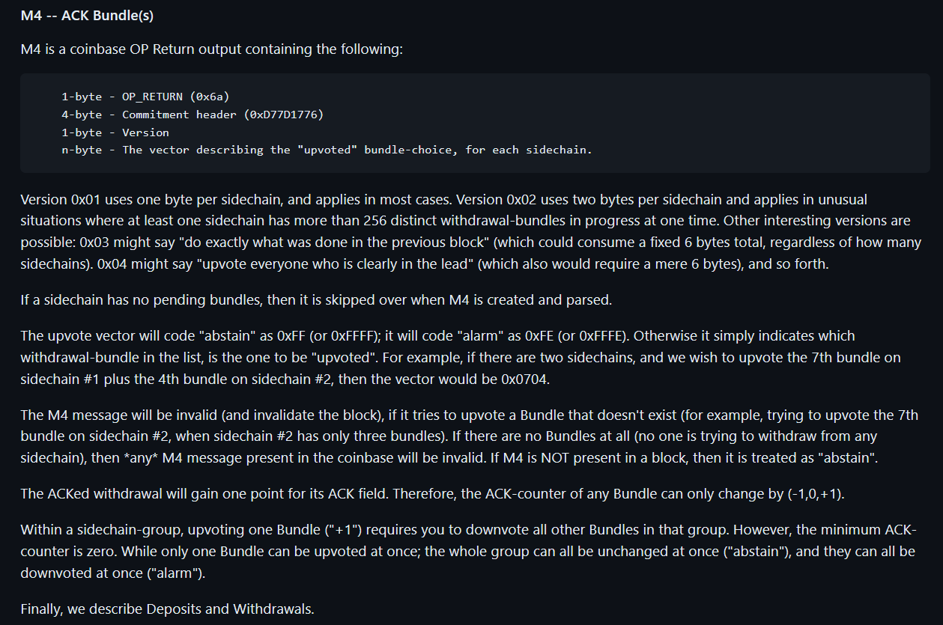
M4

Slide 50
M5 – Depositing Coins

Slide 51
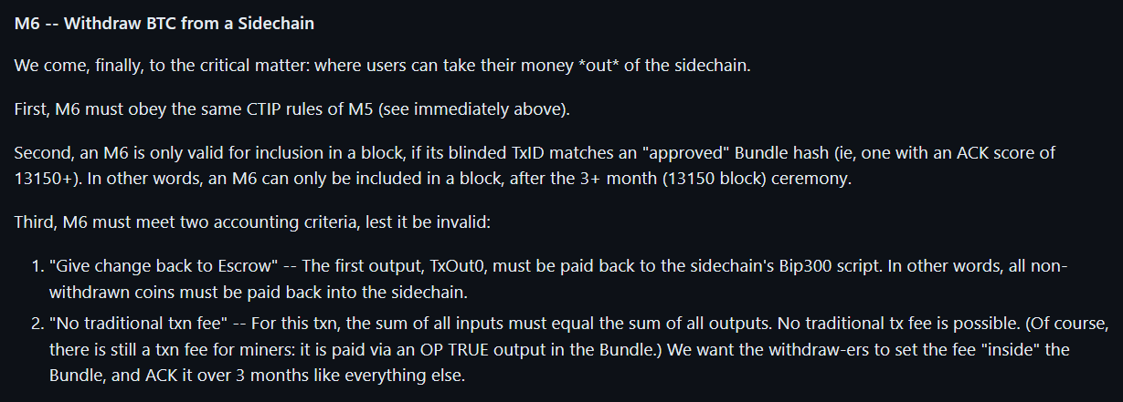
M6

Slide 52
Some Theory

Slide 53
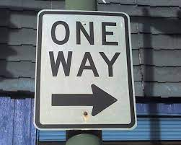
The “One Way Street”
Bip300 Drivechains
Layer 2
Bit-zCash
Bit-Monero
L2 node must have access to an L1 node
Drama
Centralization
Reorgs
Bad Design
Layer 1
Bitcoin Core
Notes:
Ok, aspect two – the base layer ( ie, Bitcoin Core, ie the mainchain, ie “layer1”) that – your Bitcoin node -- is unaffected by problems on the sidechain. Even under very extreme adversarial conditions where the sidechain experiencing all sorts of chaos, Layer1 is just going to solider on, and ignore all of that. The drama can only go one way. So, let me try to explain this.

Slide 54
The “One Way Street”
Bip300 Drivechains
Bit-zCash
Bit-Monero
Layer 2
Drama?
“I’m having a problem with my ring signatur---”
Drama
Centralization
Reorgs
Bad Design
Layer 1
Bitcoin Core
Notes:
Ok, aspect two – the base layer ( ie, Bitcoin Core, ie the mainchain, ie “layer1”) that – your Bitcoin node -- is unaffected by problems on the sidechain. Even under very extreme adversarial conditions where the sidechain experiencing all sorts of chaos, Layer1 is just going to solider on, and ignore all of that. The drama can only go one way. So, let me try to explain this.

Slide 55
The “One Way Street”
Bip300 Drivechains
Bit-zCash
Bit-Monero
Layer 2
Drama?
“I’m having a problem with my ring signatur---”
Drama
Centralization
Reorgs
Bad Design
Layer 1
Can’t hear you, sorry.
Bitcoin Core
Notes:
Ok, aspect two – the base layer ( ie, Bitcoin Core, ie the mainchain, ie “layer1”) that – your Bitcoin node -- is unaffected by problems on the sidechain. Even under very extreme adversarial conditions where the sidechain experiencing all sorts of chaos, Layer1 is just going to solider on, and ignore all of that. The drama can only go one way. So, let me try to explain this.

Slide 56
The “One Way Street”
Bip300 Drivechains
Bit-zCash
Bit-Monero
Layer 2
Drama?
Drama
Centralization
Reorgs
Bad Design
What’s that?? Oh Sorry can’t hear you. Enjoying my music over here.
Layer 1
Bitcoin Core
Notes:
Ok, aspect two – the base layer ( ie, Bitcoin Core, ie the mainchain, ie “layer1”) that – your Bitcoin node -- is unaffected by problems on the sidechain. Even under very extreme adversarial conditions where the sidechain experiencing all sorts of chaos, Layer1 is just going to solider on, and ignore all of that. The drama can only go one way. So, let me try to explain this.

Slide 57
Putting Hash(L2) into L1
= Block Header
= List of transactions
December 2020
January 2021
February 2021
March 2021
April 2021
Base Layer (Bitcoin Core)
Notes:
Here is a representation of Bitcoin’s blockchain. The squares are block headers, and the trailing rectangles are the list of transactions in each block. (Because blocks aren’t always the same size, of course.) And time is flowing from left to right. You can see across the top I’m going from Dec to April. Normally, of course, there would be tens of thousands of blocks (from Dec to April), that wouldn’t have FIT on the slides so there’s only seventeen. Now, what if there was a sidechain, activated, this whole time? Like a clone of Monero, or something. Well, we’ll put it up...

Slide 58
Putting Hash(L2) into L1
= Block Header
= List of transactions
December 2020
January 2021
February 2021
March 2021
April 2021
Layer 2 (Bit-Monero)
Base Layer (Bitcoin Core)
Notes:
Here it is. It has its own blocks, and its own block headers, and its own block chain, from December (on the left) to April (on the right). Now, the idea is ... that ...

Slide 59
Putting Hash(L2) into L1
= Block Header
= List of transactions
December 2020
January 2021
February 2021
March 2021
April 2021
Layer 2 (Bit-Monero)
e320
81cd
3 Months = One 32-byte Hash
3 Months = One 32-byte Hash
e320b6c2fffc8d750423db8b1eb942ae710e951ed797f7affc8892b0f1fc122b
81cd02ab7e569e8bcd9317e2fe99f2de44d49ab2b8851ba4a308000000000000
Base Layer (Bitcoin Core)
e320 ... Pays Out
Notes:
... Three months of sidechain activity are compressed into one little 64-character string here. And that string is the only thing inserted into Layer1. Ever. So, no matter what Bit-Monero over here is doing, this is all that layer1 will see.. ready ?

Slide 60
Your Layer 1 Node Sees…
Putting Hash(L2) into L1
Base Layer (Bitcoin Core)
e320b6c2fffc8d750423db8b1eb942ae710e951ed797f7affc8892b0f1fc122b
e320 ... Pays Out
81cd02ab7e569e8bcd9317e2fe99f2de44d49ab2b8851ba4a308000000000000
Notes:
This. Therefore, full nodes (on Layer1, down here in blue); they do not check anything that is happening on the sidechain (where there can be, theoretically, unlimited complexity). The sidechain doesn’t need to be a blockchain, it doesn’t need to be written in c++, it can make all kinds of mistakes. Etc. Bip300 operates entirely off of this one little string (here in green). (!) It does a lot of logic to that 4 little string, and assumptions and engineering, game theory economics, etc. I don’t have time to explain all of it. But the point is that Layer1 can’t be harmed by Layer2 because it really is ignoring Layer2. I feel compelled to drive this point even further, so...

Slide 61
But then how is it secure??

Slide 62
Miners
Optimizing: kWh /$ / ASIC Efficiency / Cooling / Labor / Demand Management Programs / Drying Fruit / Getting NatGas Credits / Outcompeting All Rivals
Full Node
Validating L1
+ counting to 13,150
+ add/remove/validate Sidechains

Slide 63
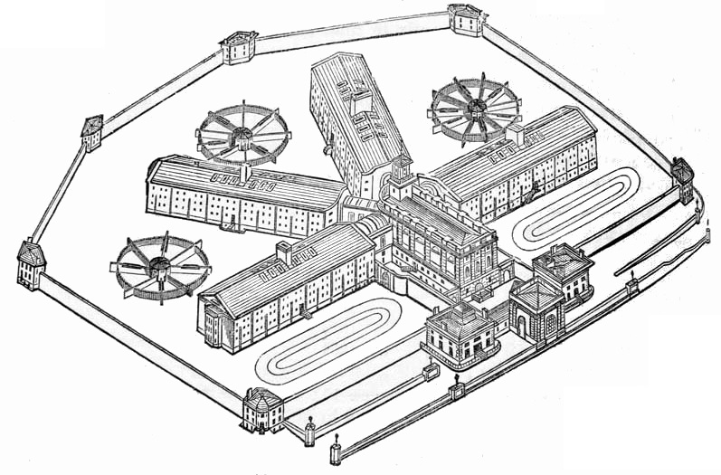
Prison Metaphor
Prison
BTC
…
Only way out.
13,150 Gates

Slide 64
Summary
Txn Fees
Token Value
Miners
e
New source of miner-profits.
Miners choice: claim this revenue, or destroy it.
High-Auditability:
Reducing “all txns” down to “net transfers”.
Crunching all xfers down to 32 bytes.
One transfer at a time.
Transfers take 3 months to settle.
Notes:
Earn money from running the prison.

Slide 65
Miners can already:
Steal from LN channels – by censoring the justice txn
Reorg mainchain Bitcoin txns out, and hold them hostage
Block any message from L1 – including zk-proofs
So, marginally, it is not actually very large an assumption.

Slide 66
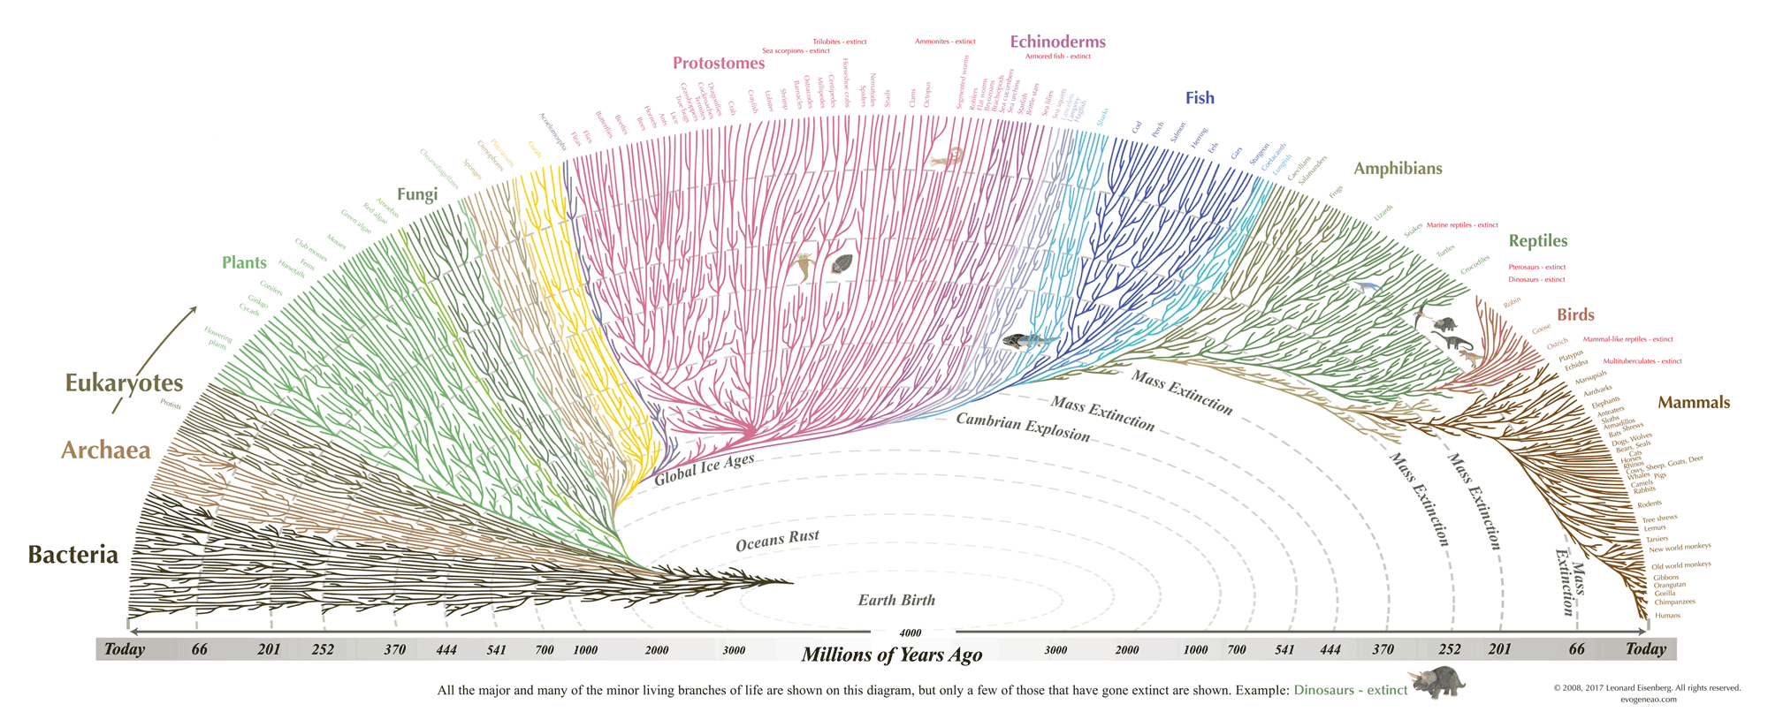
Thank You for Your Attention! Questions?
Notes:
Ok that’s the talk, thank you! : )

Slide 67
Two Supposed Drawbacks
(#1) Miners-Can-Steal from Bip300 Scripts (and this is bad)
Hashrate
fixed
cost
0%
100%
(#2) Merged-Mining is a Side-Hustle (and those are bad)
eb942ae710e951ed797e320b6c2fffc8d750423db8b1f2b0f1fc122b7affc889
eb94 ... Pays Out
e320b6c2fffc8d750423db8b1eb942ae710e951ed797f7affc8892b0f1fc122b
Notes:
… Ok now for those *drawbacks*. Here they are. The first supposed drawback of Bip300, is that miners can ---with a little bit of setup and technical knowledge and effort on their part, and certainly patience--- miners can remove all the coins from a Bip300 sidechain, and pay those coins, to themselves. Hence it is called the “miners- can-steal” problem. Here you see an evil miner, replacing that one hash I mentioned before with a different hash, and then it eventually pays out (to the miner). The second, supposed drawback of Bip300, *sigh* is: if some miners ever have a profitable side- hustle, then maybe some other miners might not be able to have that side hustle. And then they might go out of business; and wouldn’t be able to buy as many Xmas presents for their children.

Slide 68
(#1) Miners-Can-Steal from Bip300 Scripts (and this is bad) | (#2) Merged-Mining is a Side-Hustle (and those are always bad)
The free market allows entrepreneurs to go bankrupt – this is an essential part of creativity. True: not every SC will succeed. But those few that do, will pay fees to miners and boost BTC’s appeal (since BTC can now easily do everything). The failures will serve as a warning to lazy or incompetent developers. | The fixed cost in question… …is zero under BMM. …was already microscopic, vs other miner fixed costs. …must always be small enough for non-mining nodes to exist (since their revenue is the smallest of all, $0.)
Bip300 has multiple safeguards in place to make “stealing” difficult. Stealing requires 3-6 months of openly dishonest mining activity. Humans can audit theft, by checking just 32 bytes. | Mining is a complex task involving many “sub-tasks” (getting cheap power / sourcing good ASICs / etc). Each has its own incentives, innovation, and fixed costs. No stopping those.
Miners “can” steal from Lightning Network (by broadcasting old state + censoring Justice Txns), but this criterion is never held against LN. | Bizarre implications: if BitFury sold t-shirts on the side, for profit, then t-shirts = bad for BTC. If Saylor altruistically paid miners $0.10 per year, then MS = bad for Bitcoin.
The user is sovereign. Users are allowed to sell their BTC for USD; or use BTC to buy “bad” products (ie “drugs”). Or invest in Alts / scams. Bip300 allows users to spend BTC to a script. | MM is the opposite of bad – it is good and necessary. MM alone can boost BTC’s fee revenues by 10,000x or more. Without MM, long run hashrate may be too low.
This supposed “flaw” is actually a pro, as it gives miners motive and opportunity to destroy “parasite sidechains” (SC which antagonize other SCs). I am not aware of any other way of efficiently accomplishing this. And I believe it is prerequisite for high-quality smart contracts. | What is probably happening is that people are confusing node costs with mining costs. Node costs *must* be low, for decentralization. But mining costs have no such requirement. In fact, if we wanted mining costs to be low we could remove the upward difficulty adjustments.
The whole point of SCs is that Layer1 nodes ignore them. With federations, you trust a fixed committee of law-abiding people. With BIp300 you trust a decentralized P2P process. | MM is already unblockable. Satoshi invented MM in 2010, and envisioned many independent MM chains. We have been MM since 2011, with no end in sight.
Notes:
Both of these are so, false, that its hard to know where to begin.

Slide 69
(#1) Miners-Can-Steal from Bip300 Scripts (and this is bad) | (#2) Merged-Mining is a Side-Hustle (and those are always bad)
The free market allows entrepreneurs to go bankrupt – this is an essential part of creativity. True: not every SC will succeed. But those few that do, will pay fees to miners and boost BTC’s appeal (since BTC can now easily do everything). The failures will serve as a warning to lazy or incompetent developers. | The fixed cost in question… …is zero under BMM. …was already microscopic, vs other miner fixed costs. …must always be small enough for non-mining nodes to exist (since their revenue is the smallest of all, $0.)
Bip300 has multiple safeguards in place to make “stealing” difficult. Stealing requires 3-6 months of openly dishonest mining activity. Humans can audit theft, by checking just 32 bytes. | Mining is a complex task involving many “sub-tasks” (getting cheap power / sourcing good ASICs / etc). Each has its own incentives, innovation, and fixed costs. No stopping those.
Miners “can” steal from Lightning Network (by broadcasting old state + censoring Justice Txns), but this criterion is never held against LN. | Bizarre implications: if BitFury sold t-shirts on the side, for profit, then t-shirts = bad for BTC. If Saylor altruistically paid miners $0.10 per year, then MS = bad for Bitcoin.
The user is sovereign. Users are allowed to sell their BTC for USD; or use BTC to buy “bad” products (ie “drugs”). Or invest in Alts / scams. Bip300 allows users to spend BTC to a script. | MM is the opposite of bad – it is good and necessary. MM alone can boost BTC’s fee revenues by 10,000x or more. Without MM, long run hashrate may be too low.
This supposed “flaw” is actually a pro, as it gives miners motive and opportunity to destroy “parasite sidechains” (SC which antagonize other SCs). I am not aware of any other way of efficiently accomplishing this. And I believe it is prerequisite for high-quality smart contracts. | What is probably happening is that people are confusing node costs with mining costs. Node costs *must* be low, for decentralization. But mining costs have no such requirement. In fact, if we wanted mining costs to be low we could remove the upward difficulty adjustments.
The whole point of SCs is that Layer1 nodes ignore them. With federations, you trust a fixed committee of law-abiding people. With BIp300 you trust a decentralized P2P process. | MM is already unblockable. Satoshi invented MM in 2010, and envisioned many independent MM chains. We have been MM since 2011, with no end in sight.
c
Notes:
So, Bip300 is designed, to prevent miners from stealing from sidechains. But, it is nonetheless possible. Similarly, – miners “can” (can in quotes **) steal from the LN. In fact its much easier for miners to steal from the LN, since Bip300 has this 6 month timeout period. So, were you worried about miners stealing from the lightning network a moment ago? If so, just cross off this entire left half of the page. I have to stress: this comparison isn’t to knock the LN, I’m saying that the criterion is stupid. 51% hashrate can do a lot of horrible things, but that doesn’t stop us from allowing users to opt-in to certain tradeoffs. After all, its Bitcoin not Prison.

Slide 70
(#1) Miners-Can-Steal from Bip300 Scripts (and this is bad) | (#2) Merged-Mining is a Side-Hustle (and those are always bad)
The free market allows entrepreneurs to go bankrupt – this is an essential part of creativity. True: not every SC will succeed. But those few that do, will pay fees to miners and boost BTC’s appeal (since BTC can now easily do everything). The failures will serve as a warning to lazy or incompetent developers. | The fixed cost in question… …is zero under BMM. …was already microscopic, vs other miner fixed costs. …must always be small enough for non-mining nodes to exist (since their revenue is the smallest of all, $0.)
Bip300 has multiple safeguards in place to make “stealing” difficult. Stealing requires 3-6 months of openly dishonest mining activity. Humans can audit theft, by checking just 32 bytes. | Mining is a complex task involving many “sub-tasks” (getting cheap power / sourcing good ASICs / etc). Each has its own incentives, innovation, and fixed costs. No stopping those.
Miners “can” steal from Lightning Network (by broadcasting old state + censoring Justice Txns), but this criterion is never held against LN. | Bizarre implications: if BitFury sold t-shirts on the side, for profit, then t-shirts = bad for BTC. If Saylor altruistically paid miners $0.10 per year, then MS = bad for Bitcoin.
The user is sovereign. Users are allowed to sell their BTC for USD; or use BTC to buy “bad” products (ie “drugs”). Or invest in Alts / scams. Bip300 allows users to spend BTC to a script. | MM is the opposite of bad – it is good and necessary. MM alone can boost BTC’s fee revenues by 10,000x or more. Without MM, long run hashrate may be too low.
This supposed “flaw” is actually a pro, as it gives miners motive and opportunity to destroy “parasite sidechains” (SC which antagonize other SCs). I am not aware of any other way of efficiently accomplishing this. And I believe it is prerequisite for high-quality smart contracts. | What is probably happening is that people are confusing node costs with mining costs. Node costs *must* be low, for decentralization. But mining costs have no such requirement. In fact, if we wanted mining costs to be low we could remove the upward difficulty adjustments.
The whole point of SCs is that Layer1 nodes ignore them. With federations, you trust a fixed committee of law-abiding people. With BIp300 you trust a decentralized P2P process. | MM is already unblockable. Satoshi invented MM in 2010, and envisioned many independent MM chains. We have been MM since 2011, with no end in sight.
Notes:
The second one is even sillier. I think what I would like to highlight is that the implications are ridiculous. So, if BitFury sold t-shirts on the side, for profit, then t-shirts = bad for BTC. They would be as bad for Bitcoin as Bip300 is, anyway. If Michal Saylor altruistically paid miners $0.10 per year, then MS = bad for 9 Bitcoin. Blah blah blah... I think what’s really happening here, is that people are confusing nodes with miners. Miners run nodes, but not the other way around. We want nodes to be as cheap as possible. That is absolutely important; but we don’t want mining to be as cheap as possible. If we wanted that, we could just get rid of all of the upward difficulty adjustments. So I have total contempt for these two supposed drawbacks. In fact both of them are not drawbacks at all…

Slide 71
(#1) Miners-Can-Steal from Bip300 Scripts (and this is bad) | (#2) Merged-Mining is a Side-Hustle (and those are always bad)
The free market allows entrepreneurs to go bankrupt – this is an essential part of creativity. True: not every SC will succeed. But those few that do, will pay fees to miners and boost BTC’s appeal (since BTC can now easily do everything). The failures will serve as a warning to lazy or incompetent developers. | The fixed cost in question… …is zero under BMM. …was already microscopic, vs other miner fixed costs. …must always be small enough for non-mining nodes to exist (since their revenue is the smallest of all, $0.)
Bip300 has multiple safeguards in place to make “stealing” difficult. Stealing requires 3-6 months of openly dishonest mining activity. Humans can audit theft, by checking just 32 bytes. | Mining is a complex task involving many “sub-tasks” (getting cheap power / sourcing good ASICs / etc). Each has its own incentives, innovation, and fixed costs. No stopping those.
Miners “can” steal from Lightning Network (by broadcasting old state + censoring Justice Txns), but this criterion is never held against LN. | Bizarre implications: if BitFury sold t-shirts on the side, for profit, then t-shirts = bad for BTC. If Saylor altruistically paid miners $0.10 per year, then MS = bad for Bitcoin.
The user is sovereign. Users are allowed to sell their BTC for USD; or use BTC to buy “bad” products (ie “drugs”). Or invest in Alts / scams. Bip300 allows users to spend BTC to a script. | MM is the opposite of bad – it is good and necessary. MM alone can boost BTC’s fee revenues by 10,000x or more. Without MM, long run hashrate may be too low.
This supposed “flaw” is actually a pro, as it gives miners motive and opportunity to destroy “parasite sidechains” (SC which antagonize other SCs). I am not aware of any other way of efficiently accomplishing this. And I believe it is prerequisite for high-quality smart contracts. | What is probably happening is that people are confusing node costs with mining costs. Node costs *must* be low, for decentralization. But mining costs have no such requirement. In fact, if we wanted mining costs to be low we could remove the upward difficulty adjustments.
The whole point of SCs is that Layer1 nodes ignore them. With federations, you trust a fixed committee of law-abiding people. With BIp300 you trust a decentralized P2P process. | MM is already unblockable. Satoshi invented MM in 2010, and envisioned many independent MM chains. We have been MM since 2011, with no end in sight.
Notes:
… the left one allows for super-reliable oracle and high-quality smart contracts, and the right one is the only thing that is going to keep hashrate security up, in the future. So, they’re not drawbacks at all, in fact they’re both pretty cool; features.

Slide 72
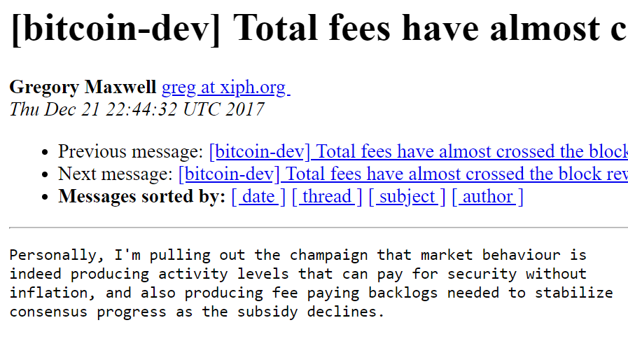
What does affect mainchain miners: Altcoins

Slide 73
What does affect mainchain miners: Altcoins
Price
(sat/byte)
R1
Quantity
(bytes)
R1 > R2

Slide 74
High Fees → Less Usage Last 2 Years, Log Scales, 7d average

Slide 75
Fee revenues are important…

Slide 76
…and supply affects Fee Revenues.
Price
(sat/byte)
R1
Quantity
(bytes)
R1 > R2

Slide 77
What does affect mainchain miners: Altcoins
Price
(sat/byte)
Quantity
(bytes)
R1 < R2
( See my blog post: “Two types of Blockspace Demand” for more. )

Slide 78
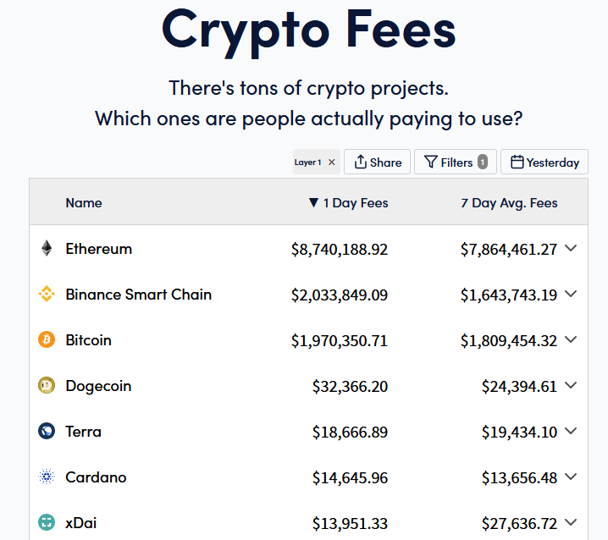
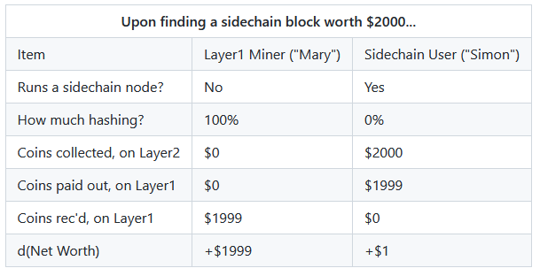
(#3) Improve Mining Incentives (Bip 301)
Get all of the fees, on all of the chains!
Miners can ignore Sidechain / Altcoin software.
Taken from https://cryptofees.info/ this morning.
June 4, 2021
Notes:
Okay third aspect. This one is only this one slide here. Third aspect is that we want to improve Mining Incentives (Bip301). This is technically Bip301, now. I separated the two BIPs, to make them easier to read. But I think anyone with a brain who uses Bip300, would use Bip301 also – but you don’t have to. Anyway, with Blind Merged Mining (BIP 301), miners don’t need to pay attention to Sidechains, at all. So, layer1 users already weren’t paying attention, now layer1 miners can also ignore Sidechains (if they want). They still collect all of the transaction fee-revenues from the sidechain’s txn! How? Well, they contract with someone else who is running a sidechain full node, and the miner sells them the block- rights, basically.

Slide 79
(#3) Improve Mining Incentives (Bip 301)
Get all of the fees, on all of the chains!
Miners can ignore Sidechain / Altcoin software.
Taken from https://cryptofees.info/ this morning.
June 4, 2021
Notes:
Here’s the important part – Miners don’t run a sidechain node, but they still get all the money. Therefore, if miners just do what they normally do, today, and include the txns which pay the highest total fees, then they will automatically mine all sidechain blocks and collect revenue from all the 5 sidechain transactions. Ultimately, I think this concept could boost fee-revenues by 1000x, if not much more. But I don’t have time to tell you about it -- I did write two articles about “Security Budget” that you can look up if you want. Something I want to mention, is that I gave this talk at Bitcoin2021 in June, using these little numbers over here; (on the right). And yesterday I updated the slide…

Slide 80
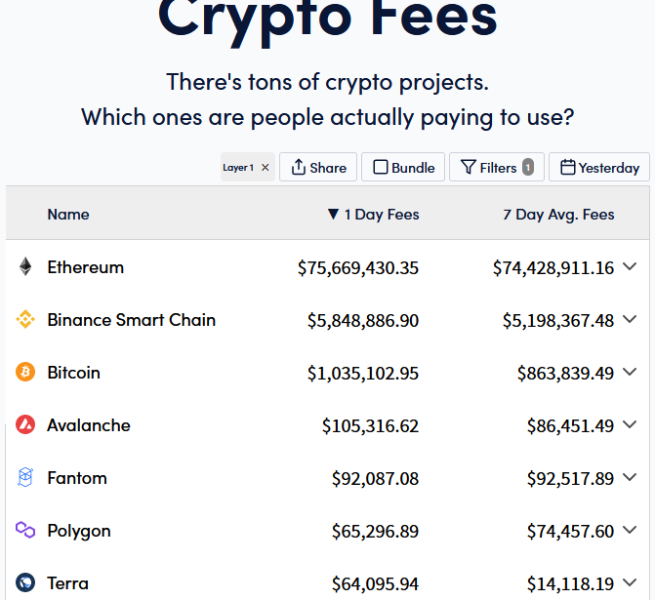
(#3) Improve Mining Incentives (Bip 301)
Get all of the fees, on all of the chains!
Miners can ignore Sidechain / Altcoin software.
+846%
+216%
-52%
Taken from https://cryptofees.info/ this morning.
November 4, 2021
June 4, 2021
Notes:
Bitcoin revenues are down, ETH revenues are way up. Maybe that was unlucky timing, *shrug*. Just something to think about.

