Slide 1
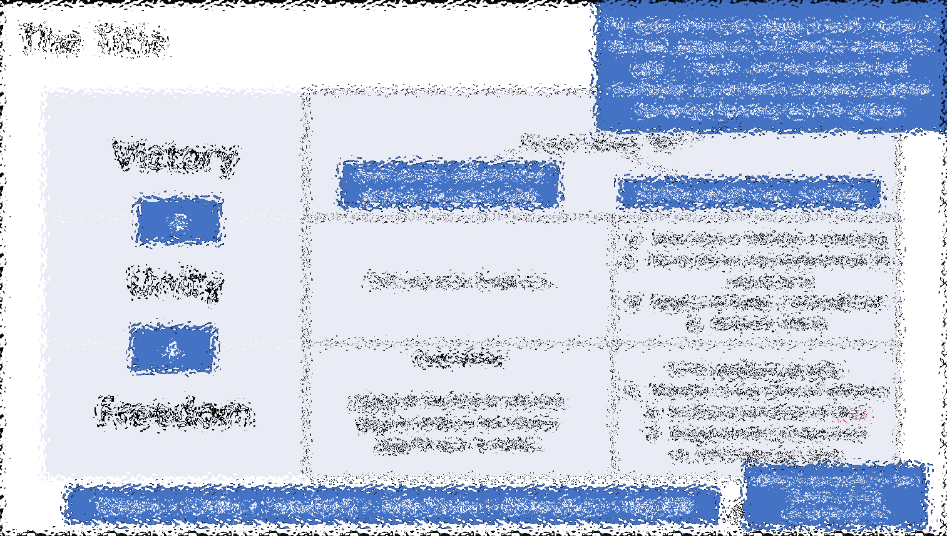
Victory, Unity, and Freedom – via Sidechains
Paul Sztorc
Feb 14, 2024 Anarchapulco

Slide 2
Agenda
Introduction
The Title (“Victory, Unity, and Freedom – via sidechains”)
What is the Sidechain,
Visual Aids
Try it Today
Why this will win
Bip300 for Miners
How You Can Help
30 min
10 min
Q&A, or – Appendix Slides

Slide 3
My 1000+ Pages About Bitcoin
2012-2014 | Statistician, Yale Econ → Bitcoin Researcher
Notes:
Before I was a CEO, I described myself as a Bitcoin Researcher.

Slide 4
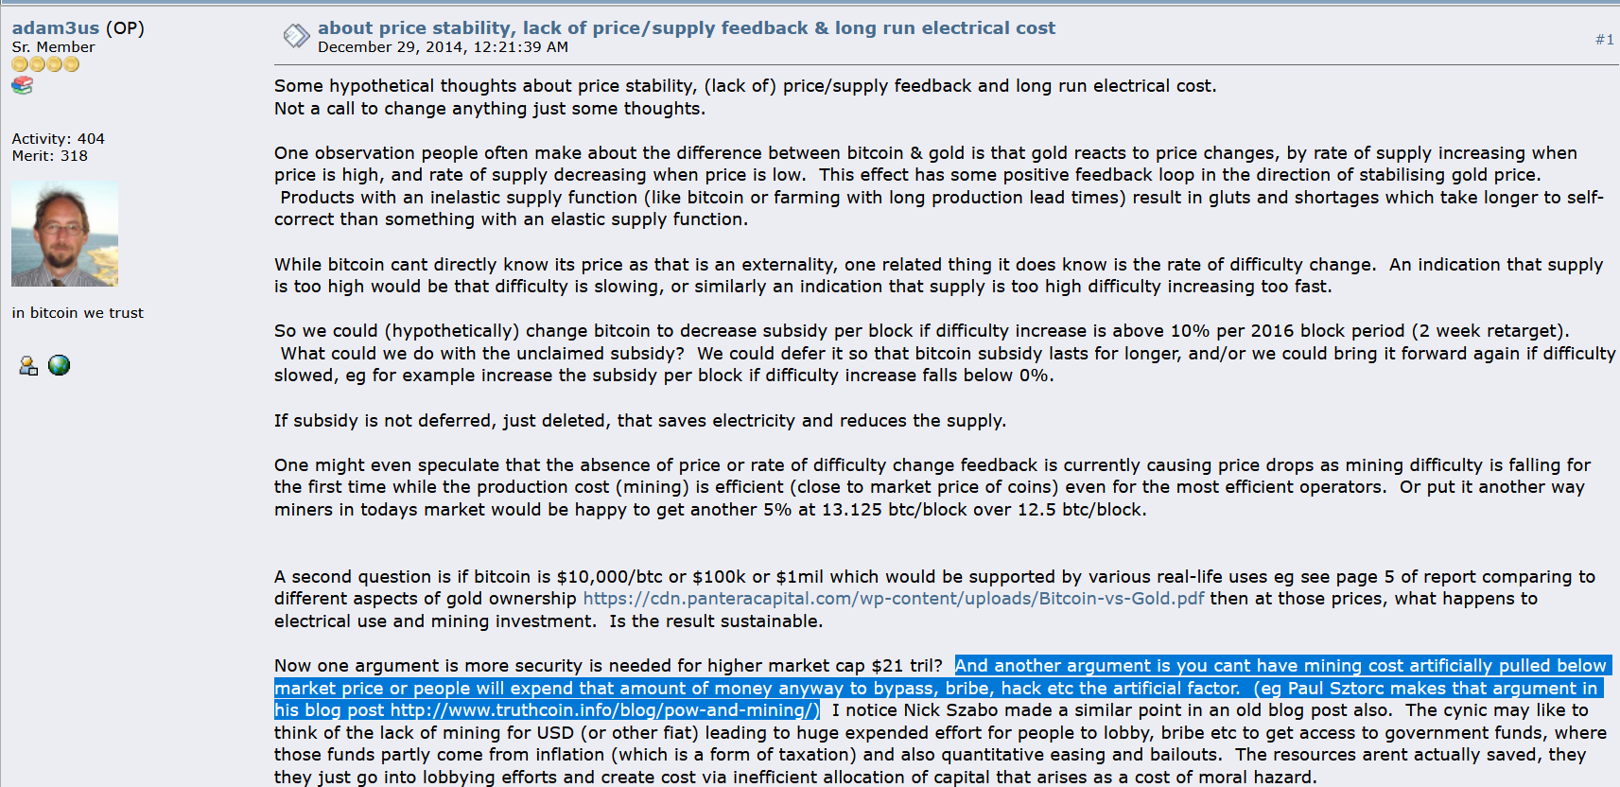
My Big Break
Dec 2014 – Adam Back links to my blog

Slide 5
Since Then…
2013/2014 -- wrote code/whitepaper for P2P oracle (BitcoinHivemind.com)
Technical Talks
Scaling Bitcoin 1 2 & 3 -- Program Committee for #4
TabConf every year – keynoted in 2018
BitDevs – Summer 2014 (NYC), Austin (May 2018)
Bitcoin Wednesday – all around the globe (Toronto, Chicago, Amsterdam, etc)
Consensus Construct (2017, 2019); American Banker ; Qcon London (2017)
Bitcoin Miami 2019/2021/2022/2023 & Amsterdam (all years)
Countless podcasts, spaces, etc.
Wrote BIPs 300 and 301.
Raised $3M to start LayerTwo Labs & help Bitcoiners dominate the world.
Notes:
, since, frankly, no one else was doing it.

Slide 6
The Title
Victory | “Crypto” defeats “fiat”

Slide 7
The Title
The government can create as much money as they like, destroy as much money as they like, take … , spend . And also observe (and eventually, censor) every mutually beneficial transaction between any two citizens.
Victory | “Crypto” defeats “fiat”
Open source software that protects the user’s rights
8 billion people use it, everyday

Slide 8
The Title
The government can create as much money as they like, destroy as much money as they like, take … , spend . And also observe (and eventually, censor) every mutually beneficial transaction between any two citizens.
Victory | “Crypto” defeats “fiat”
Unity | Only one coin should win. | New coins = inflation = annoying Worry about coin-replacement (ie coin-failure) Contradiction / Regress to barter Network effects
Freedom
Open source software that protects the user’s rights
8 billion people use it, everyday
=
+
Victory = (Unity + Freedom) = Sidechains = Drivechain = Bip300

Slide 9
The Title
Victory | “Crypto” defeats “fiat”
Unity | Only one coin should win. | New coins = inflation = annoying Worry about coin-replacement (ie coin-failure) Regress to barter / contradiction Network effects
Freedom | Competition Choice of blockchain software. Easy to create a new choice. Easy for user to switch. | Solves problems of unity: Mistakes in any piece of software Laziness/corruption of devs Disagreement among users Heterogenous users
=
+
N00bs / poor people: txn fees activists: privacy normal people: UX
Victory = (Unity + Freedom) = Sidechains = Drivechain = Bip300

Slide 10
We want:
One cryptocurrency (ie, “21 million coins” only)
Multiple blockchains, run by different people who all hate each other
The ability to always add more new blockchains.
The ability for users to always switch between these as they like. … getting one of the two, is easy. But how to get both? …that is what sidechains (BIP300, “Drivechains”) provide.

Slide 11
History Lesson
Fake sidechains
Blockstream -- Oct 2014 – “Enabling Blockchain Innovations with Pegged Sidechains” | Blockstream -- Jan 2017 – “Strong Federations: An Interoperable Blockchain Solution to Centralized Third Party Risks”
Paul Sztorc (Me) – Nov 2015 – “Drivechain: the simple two-way peg” | Paul Sztorc (Me) – Jan 2017 – drivechain.info Feb 2018 – BIPs 300 & 301 Summer 2020 – zCash Sidechain Dec 2022 – LayerTwo Labs
Rugpull
Attempt to Implement
Progress
Real sidechains

Slide 12
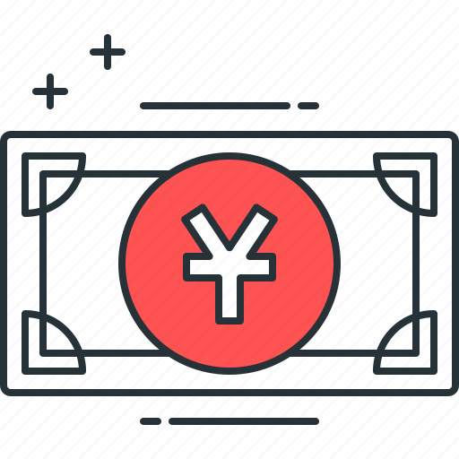
BIP300: Everything on Top of Bitcoin
zCash
FileCoin
ETH
VISA
WeChat Pay
ETH
zCash
FileCoin
BTC Today
WeChat Pay
VISA
BTC + Drivechain
Today ☹ No sidechains
Tomorrow ☺ Sidechain world
Notes:
What is BIP300 about ??

Slide 13
BIP300: Everything on Top of Bitcoin
zCash
FileCoin
ETH
VISA
WeChat Pay
ETH
zCash
FileCoin
BTC Today
WeChat Pay
VISA
BTC + Drivechain
Today ☹ No sidechains
Tomorrow ☺ Sidechain world
Notes:
6

Slide 14
WeChat Pay
VISA
ETH
BTC Today
zCash
BTC + Drivechain
FileCoin

Slide 15
Drivechain = Altcoin Tech, BTC Coin Only
“Sidechains”
n
n
Bit-Ethereum
Bit-Monero
Bitcoin
Ethereum
Monero
Bitcoin
Bip300
Bip300
BIP 300
Ethereum
Monero
Notes:
Bip300 proposes these new layer2s, that some call “sidechains”. Sidechains are a response to the threat of Altcoins, but they’re also a response to the desire of Bitcoiners for creativity, and innovation – -- you know: the desire to try new things without asking for anyone’s permission. How can we let everyone try the ideas that they like? And how do I keep other people’s bad ideas away from me? So here you see we have the world of Altcoins on the left, but then, the revenge of Bip300 on the right. We have copied Ethereum and Monero into our own projects that respect the 21M coin limit of BTC. No inflation.

Slide 16
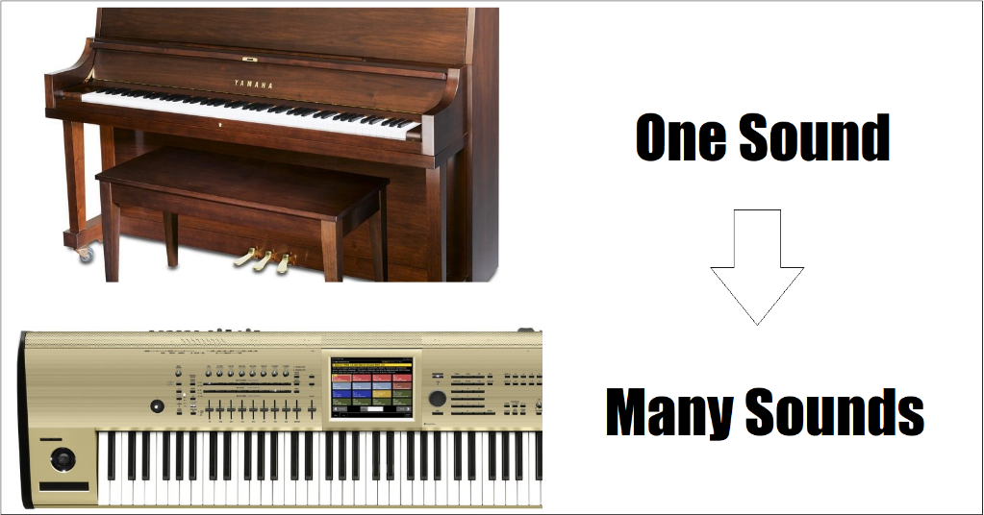
1.1) The Basic Sidechain Concept
No Bip300
Yes Bip300

Slide 17
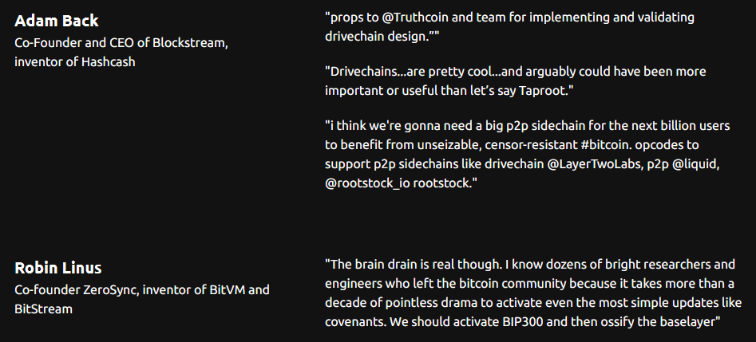
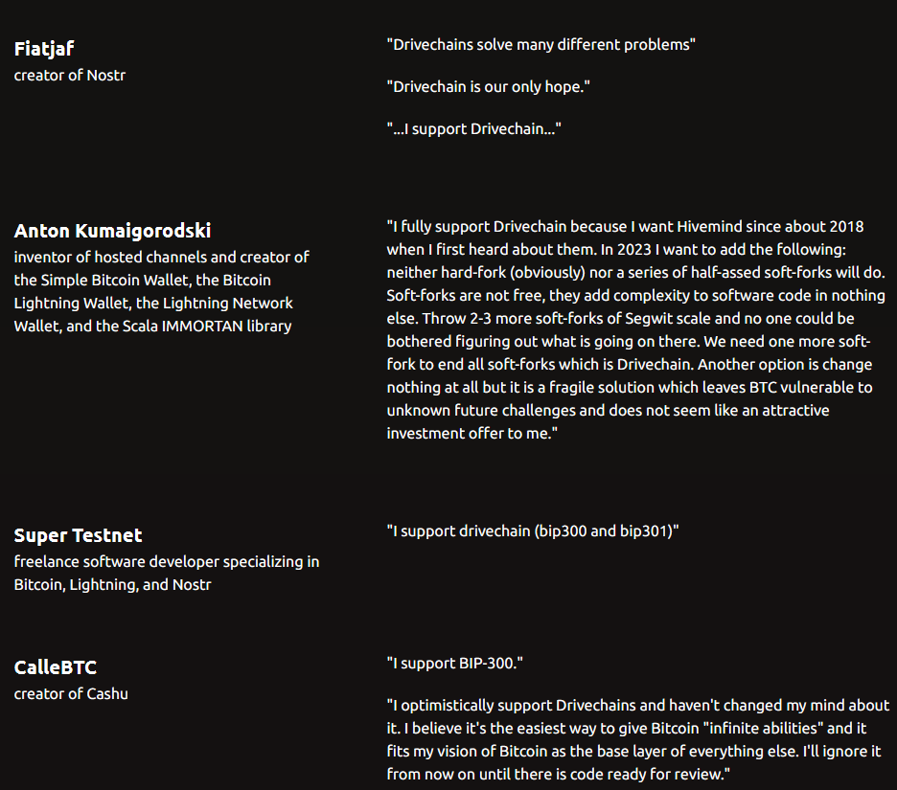
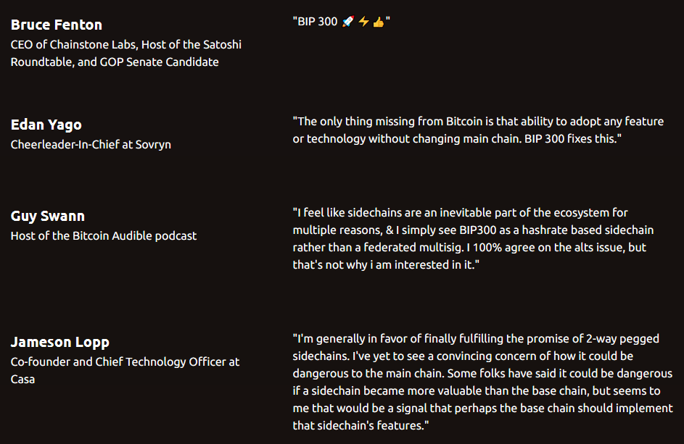
Expert Validation
see LayerTwoLabs.com/friends for links, context, & 43 more

Slide 18
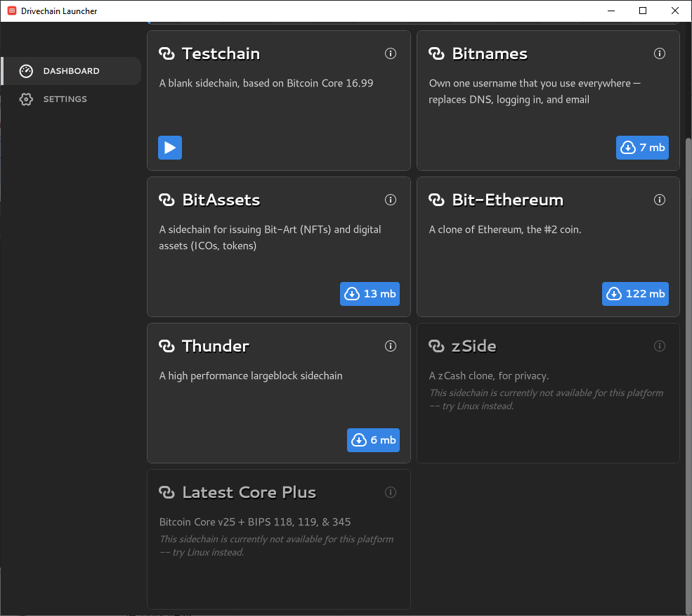
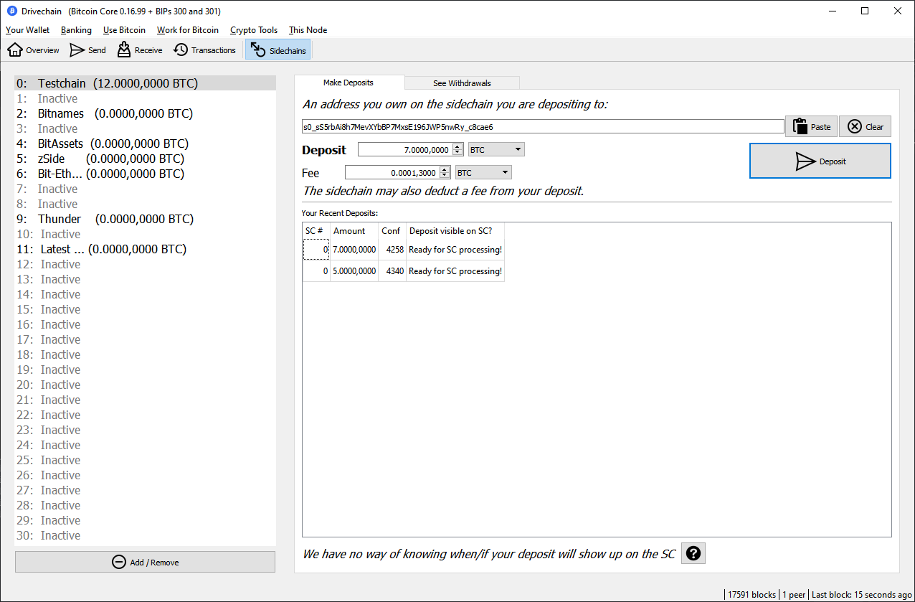
Try Our Software
Visit releases.drivechain.info -- it’s always improving!
Site: www.LayerTwoLabs.com www.drivechain.info Paul’s Twitter: @truthcoin

Slide 19
Try Our Software
Visit releases.drivechain.info -- it’s always improving!
Bit-zCash
Bit-Ethereum
Largeblock payments sidechain
BitNames (version of Namecoin)
BitAssets (version of ordinals/NFTs/XCP)
Blank sidechain for testing
Bit-Core + CTV / APP / OP Vault activated
Bit-Solana (work in progress)
Bit-FileCoin (work in progress)
Bit-Truthcoin (aka Bitcoin Hivemind, WIP)
Site: www.LayerTwoLabs.com www.drivechain.info Paul’s Twitter: @truthcoin

Slide 20
Sidechains – Miner Perspective
Every transaction, in the world, is a Bitcoin txn, and each contributes to miner-revenues.
There are many different Bitcoin Networks, to accommodate different people /usecases.
Competition among networks/devs, ie – they all hate each other.
Layer 2
Layer 1
All the world’s txns are already on some network or another. They all pay some kind of fee to someone. (VISA, Venmo)
Notes:
That’s right, I’m pro-hate. Because I’m pro-competition. The more they hate each other, the harder they will work for the user.
More users → more transaction fees, and a higher price of Bitcoin.

Slide 21
Goals of BIP 300/301
Every transaction, in the world, is a Bitcoin txn, and each contributes to miner-revenues.
There are many different Bitcoin Networks, to accommodate different people /usecases.
Competition among networks/devs, ie – they all hate each other.
BIP 300
BIP 301
Layer 2
Layer 1
All the world’s txns are already on some network or another. They all pay some kind of fee to someone. (VISA, Venmo)
Notes:
That’s right, I’m pro-hate. Because I’m pro-competition. The more they hate each other, the harder they will work for the user.
More users → more transaction fees, and a higher price of Bitcoin.

Slide 22
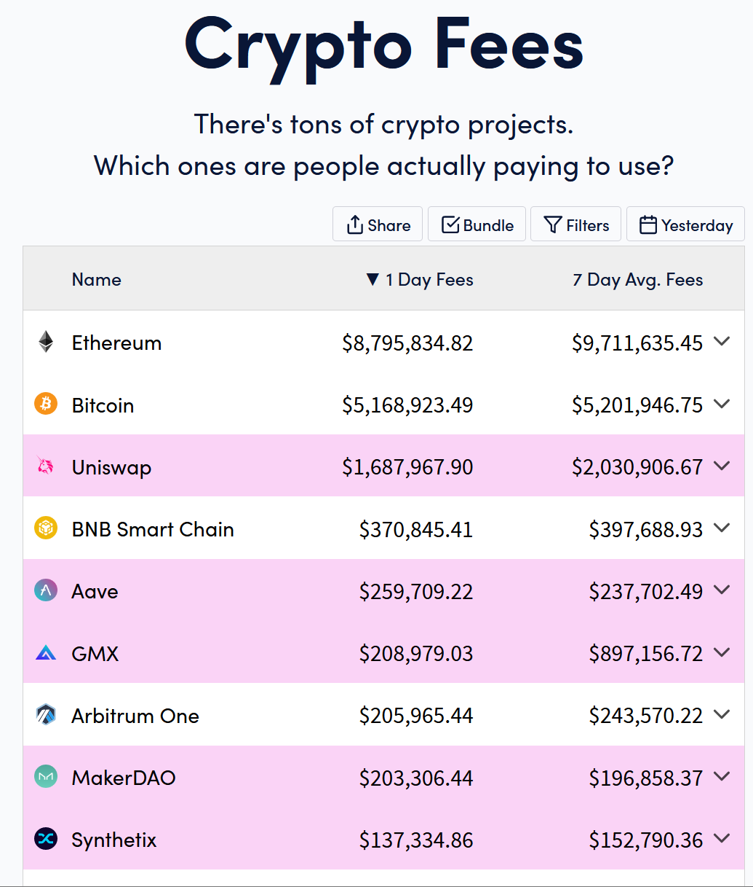
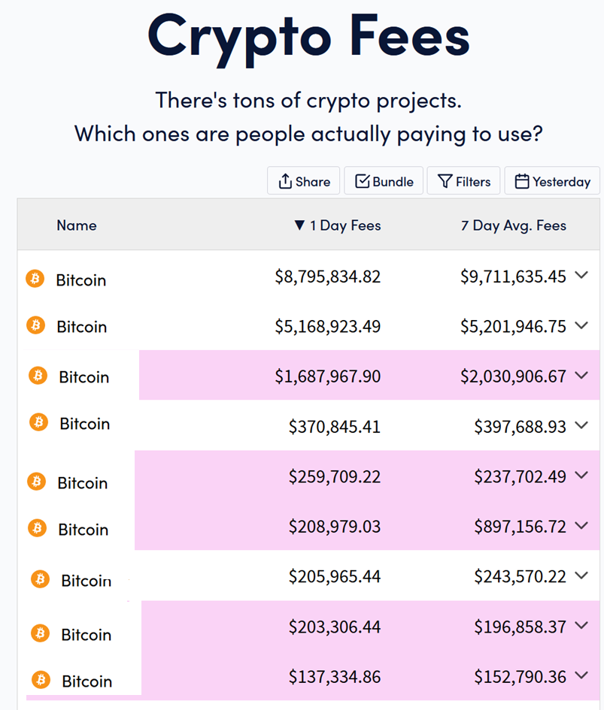
The Goal
$17,000,000
Notes:
Ok – I have an image for you.

Slide 23
The Goal
300
Bit-Ethereum
301
$17,000,000
Bit-Uniswap Bit-BNC Bit-Aave Bit-GMX Bit-Arbitrum Bit-MakerDAO Bit-Synthetix
L2 → L1
300
Alt → BTC
Notes:
Ok – I have an image for you.

Slide 24
Not limited to Existing Altcoins
Can include other networks, including centralized ones.
Or new blockchain networks we build from scratch.
Earth’s 1.1 trillion txns
At $0.10 = $100B per year in revenue. From payments alone.
Doubles roughly every ~ 5 years.
Chase revenues, instead of cutting costs.
More users = more Bitcoin adoption = higher price.
Notes:
As you will see, it doesn’t matter that it’s napkin math because the numbers are favorable to say the least.

Slide 25
Not limited to Existing Altcoins
Can include other networks, including centralized ones.
Or new blockchain networks we build from scratch.
Earth’s 1.1 trillion txns
At $0.10 = $100B per year in revenue. From payments alone.
Doubles roughly every ~ 5 years.
Chase revenues, instead of cutting costs.
More users = more Bitcoin adoption = higher price.
Important because: BIP 300/301 can be activated by 51% hashrate alone … without any change to the Bitcoin Core software.
Notes:
As you will see, it doesn’t matter that it’s napkin math because the numbers are favorable to say the least.

Slide 26
Final Thoughts -- Why BIP300 Guarantees Success
1) Commanding Heights – Capture these, and the rival currencies will surrender.
2) Batting Cleanup – Fundamental Value, “Mining Decentralization”, Anti-Scam, Security Budget, Small blocks, Creativity
3) Culture – Why static cultures always fail, how to combine progress with stability.

Slide 27
1) The Commanding Heights
Capture these 3 dimensions, and you have an insurmountable advantage:
Scalability – money has network effects. So whoever can’t scale, is at a permanent, fatal disadvantage. Bip300 allows a team of larger-block sidechains to reach planetary scale immediately, giving 8 billion people their own UTXO. See: https://www.truthcoin.info/blog/thunder/
Privacy – It is difficult to openly innovate privacy – at least, privacy of the truly subversive kind that matters. That is why it is best to just copy the already existing zCash sidechain. This was already done, back in 2020. Try it!
Ossification – It is difficult to “compete on ossification”. Whoever has gone the longest without changing, is the most ossified, no matter what the rivals do later. So, this advantage goes to whoever can ossify first. Bip300 allows us to ossify immediately – no L1 changes are ever needed ever again. Instead, they take place on L2 where they belong.

Slide 28
2) Batting Cleanup
BIP300 also solves these problems (as a kind of side-effect):
Security Budget – Miners automatically collect all txn fees from all chains, without doing any additional work. Last year ~1.1 trillion txns on Earth, @ $0.10/tx = $100B per year in miner revenue. (And this figure doubles every ~5 years.)
Fundamental Value – BIP300 focuses on fees – aka building chains that people use. See: truthcoin.info/blog/bitnames/ + truthcoin.info/blog/bit-assets/ + bitcoinhivemind.com/ This drives real adoption – loyal users, not speculators.
Mining Decentralization – Reduce the bargaining power of pools! The best way, is to support: (1) inter-pool competition, (2) PPS/FPPS, (3) frequent on-chain pool2hasher payments. Thunder (one of our sidechains) facilitates this already. We are building optimized open source pool software, to further this use-case and set a good example.
Anti-Scam – Scams plague our industry. Bad PR and regulatory headaches. After Bip300, all innovation will be absorbed into the winning coin, not compete with it. This removes the justification for creating new coins – which is the basis of the scams.

Slide 29
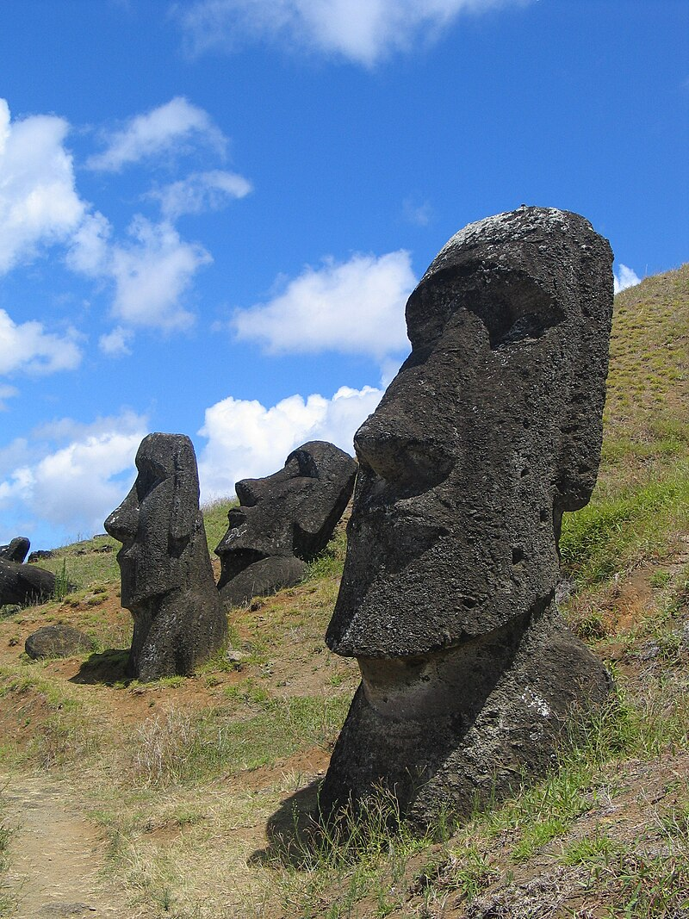
3) Culture as Suicide
“[Easter Islanders] may have arrived on the island as early as the fifth century CE. They developed a complex Stone Age civilization, which suddenly collapsed over a millennium later. By some accounts there was starvation, war and perhaps cannibalism. The population fell to a small fraction of what it had been, and their culture was lost. The prevailing theory is that the Easter Islanders brought disaster upon themselves, in part by chopping down the forest which had originally covered most of the island. They eliminated the most useful species of tree altogether. … Of the hundreds of statues on the island, built over the course of several centuries, fewer than half are at their intended destinations. The rest, including the largest, are in various stages of completion, with as many as 10% already in transit on specially built roads. Again there are conflicting explanations, but, according to the prevailing theory, it is because there was a large increase in the rate of statue-building just before it stopped for ever. In other words, as disaster loomed, the islanders diverted ever more effort not into addressing the problem – for they did not know how to do that – but into making ever more and bigger (but very rarely better) monuments to their ancestors. And what were those roads made of? Trees.” -David Deutsch, The Beginning of Infinity
VS.
Bip300 fosters L1 openness to change, & innovation. But this change is opt-in and reversible. Thus, Bip300 also fosters ossification.
See Appendix 3

Slide 30
How You Can Help
Learn and spread the word
Join the Telegram – t.me/DcInsiders
Try the software – releases.drivechain.info
Read the BIPs / read drivechain.info , to absorb the ideas
Follow me, @truthcoin on Twitter
Specifically, we eventually need either:
Bitcoin to take this idea
Core to merge the Bip300 pull request (will take years), OR
51% BTC hashrate to run the Bip300 software (MASF)
An Altcoin / Fork must take this idea

Slide 31
Thank You For Your Attention

Slide 32
Fundamental Value – Namecoin
Satoshi co-invents Namecoin in 2010
Why does today’s internet suck so much??
Namecoin Enables:
One Username – Own a single username, that works everywhere, on every site.
No more passwords! -- Login by being “pinged” with PIN via open protocol.
Easy to keep different online identities separate.
“PayMail” – Special inbox where people must pay you $ in order for the message to go through.
PayMail for introductions + Whitelists = eliminates all spam from the internet. This breaks the chokehold of Google.
On-chain PayMail is completely, 100% untraceable if you run a full node. No TOR required.
Everyone has end-to-end encryption. Everyone has a TOR / i2p website.
No seizing of ICANN domain names.
(Through Bip47 / similar), eliminates the need for Bitcoin addresses.
Notes:
In other words, Satoshi would have an email address, a zCash address, and an Instagram account and a TikTok, automatically.

Slide 33
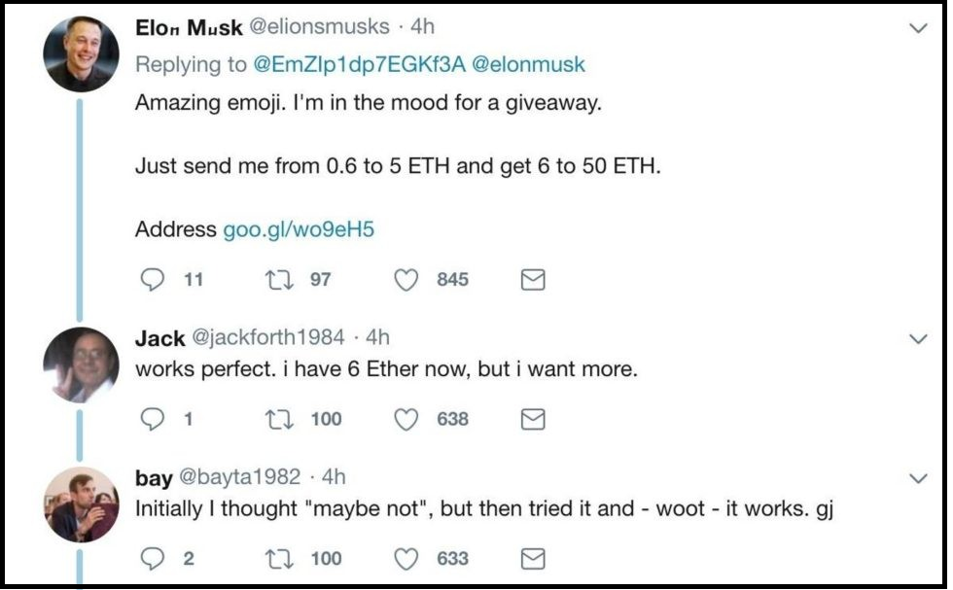
Screenshot #1 from www.truthcoin.info/blog/bitnames/
Notes:
…this is someone pretending to be Elon Musk, on Twitter…

Slide 34
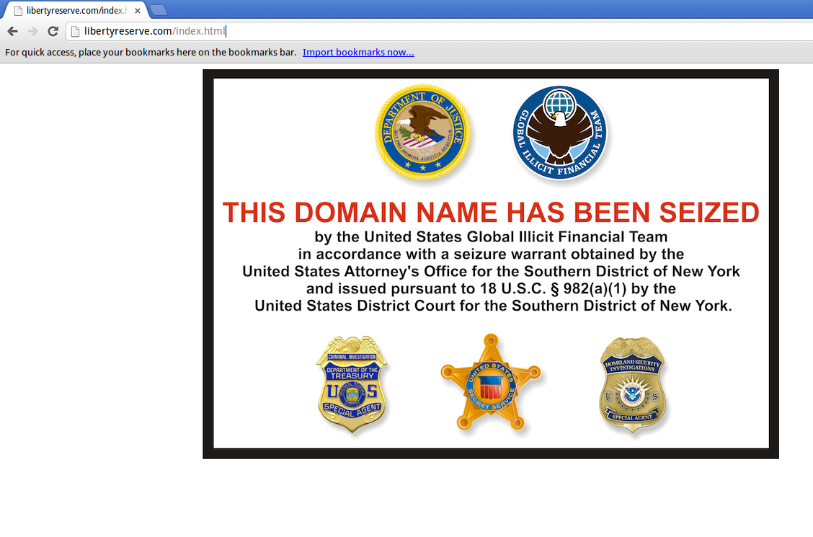
Screenshot #2 from www.truthcoin.info/blog/bitnames/
Notes:
…this is the Liberty Reserve website domain_name being seized…

Slide 35
Screenshot #3 from www.truthcoin.info/blog/bitnames/
Notes:
…this is a guy on YouTube who, in the bottom-right, has to list out all of his screennames ... and they aren’t all identical, his Facebook name is different. With BitDNS everyone would just have one login, for every service. No one could seize your account, anywhere. And people would always be able to find you.

Slide 36
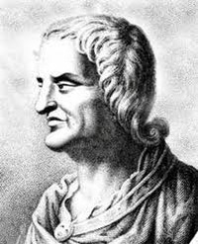
Fundamental Value – Truthcoin
Paul (me) invents Truthcoin in 2013/14
Why does today’s internet suck so much??
Truthcoin Enables:
Prediction Markets – prevents politicians/CEOs from lying.
Prevents politicians/CEOs from lying
Each voter/shareholder/whatever can become optimally informed, with zero effort.
Will counteract “rational ignorance” and Caplan-esque “rational irrationality”.
Eliminates the entire “misinformation” pipeline / food chain. (Lobbyists, pollsters, etc).
Thus, politicians will have to work as hard as possible.
Fork futures -- would have prevented the Blocksize war.
Portfolio replication – allows for stablecoins/anything-coins... no backer needed!
Paves the way for land-value-Futarchy / nirvana.
Quis custodiet ipsos custodes? – “But who is in charge of those who are in charge?”
Notes:
In other words, Satoshi would have an email address, a zCash address, and an Instagram account and a TikTok, automatically.

Slide 37
Rot From Above: Who controls what?
Informed or otherwise…
CEO / President / Senator / Editor-in-Chief
Group Opinion
C-Suite / Cabinet /
Coordinators / Reviewers
Managers / Directors /
Aides / Researchers
Shareholders /
Voters / Colleagues
Staff / Research Assistants
Result
Satisfaction of: Customers / Citizens / Readers

Slide 38
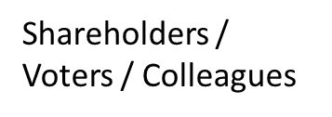
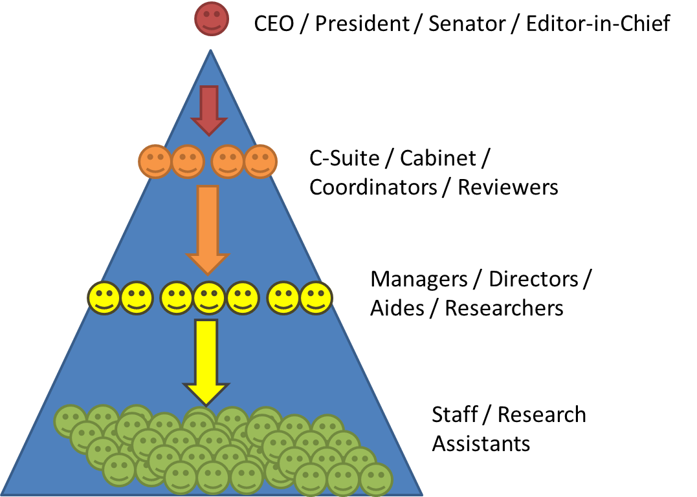
How to we combine the many preferences of this group into one request?
Do we each have to monitor the leader’s work? If not, who do we trust (and why)?
If I don’t like this leader, how do I find out if others agree? How do we fire the leader?
Bad
Prediction Markets fix this.
Can easily…
…make requests.
…observe work/results.
…fire insubordinates.
Good
Quis custodiet ipsos custodes? – “But who is in charge of those who are in charge?”

Slide 39
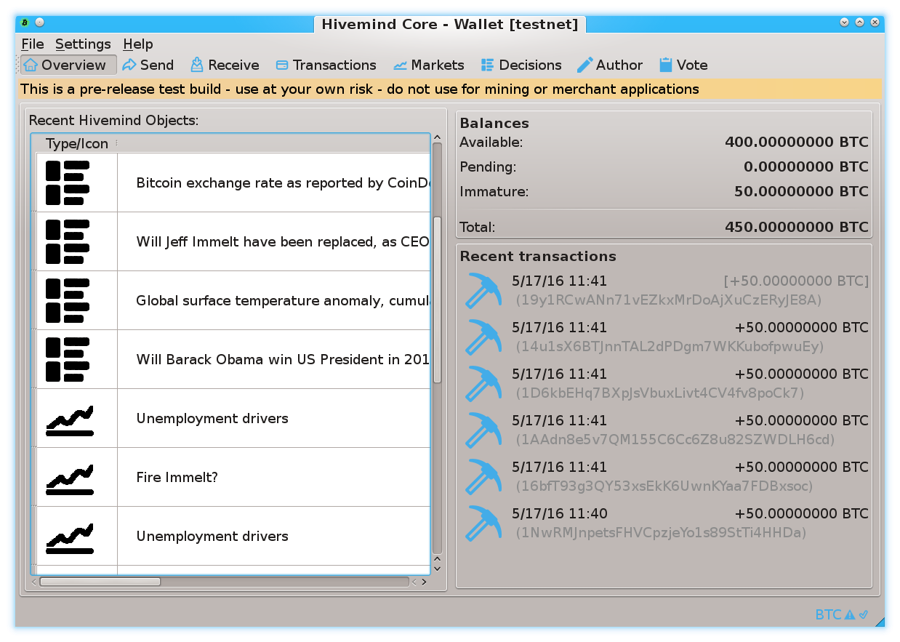
Prediction Markets
Screenshots from my own BTC sidechain project
www.BitcoinHivemind.com
Notes:
This is one of my other projects, BitcoinHivemind.com, check it out. I designed it to be a sidechain from the very beginning. Here are some screenshots…

Slide 40
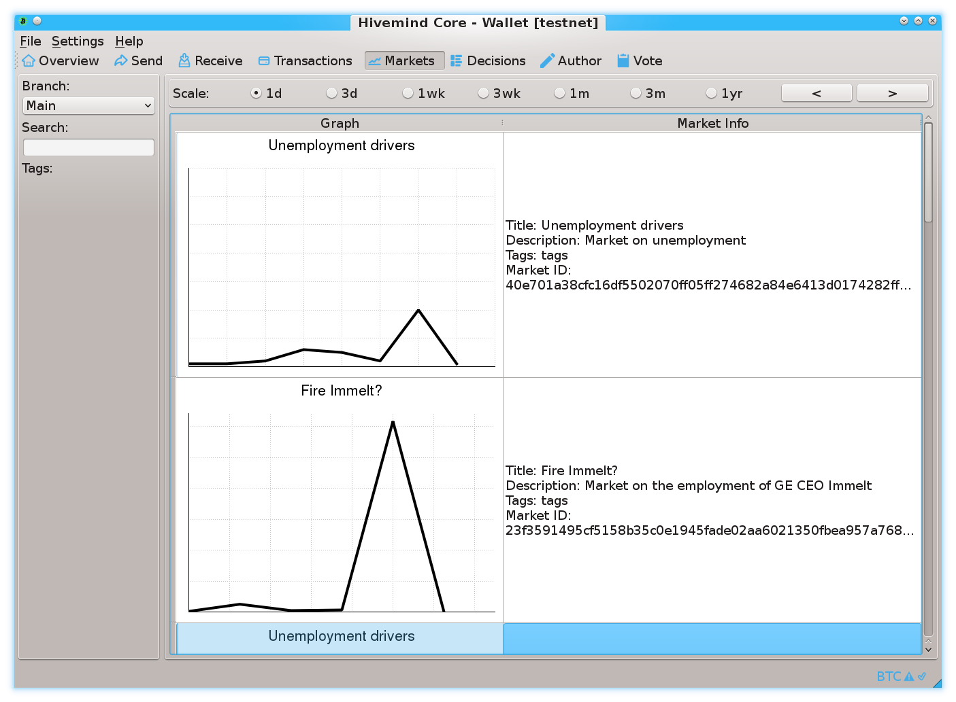
Prediction Markets
Screenshots from my own BTC sidechain project
www.BitcoinHivemind.com
Notes:
…

Slide 41
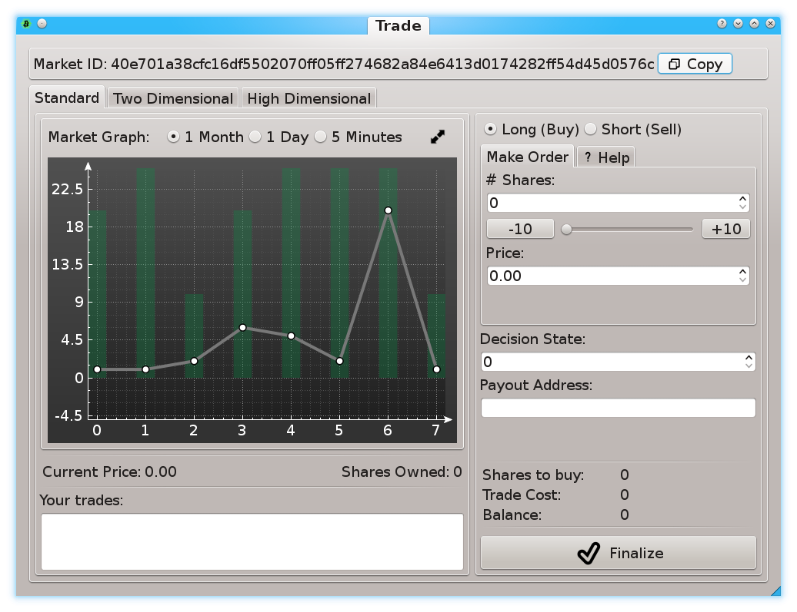
Prediction Markets
Screenshots from my own BTC sidechain project
www.BitcoinHivemind.com
Notes:
… This software can do a lot of things…

Slide 42
Prediction Markets
Screenshots from my own BTC sidechain project
www.BitcoinHivemind.com
Key Idea: “Futarchy” -- futures markets for how well certain leaders would perform, if they were in charge.
Notes:
…but the crowd favorite is ‘Futarchy’ – where there are futures markets for how well certain leaders would perform, if they were in charge. ... This idea is very distressing to bad leaders, [laugh] , because WE can learn about exactly how bad they are going to be, before we cast a vote for anyone. I think that this is one of the most important ideas in the whole world.

Slide 43
A Bold Claim
BIP300 Solves All of Bitcoin’s Biggest Problems
Heterogeneity Problem
Scalability
Privacy
Scams – Eliminating ScamCoins ; Domesticating the Token Casino
Security Budget
Decentralization
“Fundamental Value” of Bitcoin
With...
...zero risk to Bitcoin!

Slide 44
That “Zero Risk” Part
Bip300 is an easy soft fork to add to Bitcoin... And an easy soft fork to remove.
Bitcoin Core v25
BIP 300 Softfork
New Bitcoin Core
Interoperable with Core v25
A Softfork Banning all Bip300 Deposits/Withdrawals from L1
Bitcoin Core v25
New Bitcoin Core
Interoperable with Core v25
So, worst case scenario, miners just run a simple softfork, and we are exactly back to where we are today.

Slide 45
A Bold Claim
Different strokes for different folks. Flexibility to grow and change as needed.
BIP300 Solves All of Bitcoin’s Biggest Problems
Heterogeneity Problem
Scalability
Privacy
Scams – Eliminating ScamCoins ; Domesticating the Token Casino
Security Budget
Decentralization
“Fundamental Value” of Bitcoin
With...
...zero risk to Bitcoin!
Different chains for different users.
A team of region-specific chains, each with a large growing Blocksize – onboard users directly to L2.
zCash drivechain.
Have a dedicated NFT/ERC/Ordinals chain. Pay all txn fees in BTC. Clear coin roles.
Merged Mining = miners collect ALL fees from ALL chains. For free.
Shrink L1 Bitcoin Core Blocksize, and ossify (the spec at least). No more politics.
Chains are actually useful for real world tasks.
BitNames + Truthcoin ; examples

Slide 46
A. Heterogeneity
Smart Contracts DeFi Turing Completeness Ring Signatures zk-Snarks Large Blocksizes
NFTs Oracles
Mimblewimble
…(etc)
Bitcoin does seem great… but can it do _______ ?
Actually we DON’T want Bitcoin to do ______ in the first place because it is actually a bad due to _______, as you can read ______. But if by ______ you really mean ______, then yes Bitcoin can do that! Eventually we are working on _____ which should be able to do ______ even better than ______ anyway but it is actually a good thing that the protocol is so difficult to upgrade beca …
Yes. See BIP 300.
Noob
Bitcoiner
Notes:
Ideally, with Bip300, if some annoying person asks “Sure Bitcoin seems great, but can it do .... smart_contracts, DeFI, zk-snarks, blah blah, you just say “Yes, Bitcoin can do that – see Bip300”.

Slide 47
A. Heterogeneity
I can improve Bitcoin! It only needs my new idea: _______ !! When can you merge my code ??
You can’t just merge something into Bitcoin -- It affects everyone else’s nodes!! Besides, ______ has been proposed before and you need to read ______ so that you can learn why everyone hates it, especially our infallible _______ who would have done it by now if it were a good idea. ________ is a SCAM and you are trying to ATTACK BITCOIN!! Even if your idea was good it would probably take years to get consensus and get merged into …
Noob (and/or Fringe Genius)
Use BIP 300.
Good luck!!
Bitcoiner
Notes:
Similarly, if some innovator dreams up a crazy idea, “Hey I can improve Bitcoin, it only needs my new idea ... larger blocksizes, Turing Completeness, KYC-miner-coins?” Then: similarly, they now can do that without anyone’s permission. They just don’t do it on Bitcoin base layer, they do it on a Bip300 sidechain.
So: that’s the goal – FREEDOM. Developers can write whatever code they want, users can use that code if they like. Everyone gets what they want. But how is it accomplished?

Slide 48
A Bold Claim
BIP300 Solves All of Bitcoin’s Biggest Problems
Heterogeneity Problem
Scalability
Privacy
Scams – Eliminating ScamCoins ; Domesticating the Token Casino
Security Budget
Decentralization
“Fundamental Value” of Bitcoin
With...
...zero risk to Bitcoin!
Different chains for different users.
A team of region-specific chains, each with a large growing Blocksize – onboard users directly to L2.
zCash drivechain.
Have a dedicated NFT/ERC/Ordinals chain. Pay all txn fees in BTC. Clear coin roles.
Merged Mining = miners collect ALL fees from ALL chains. For free.
Shrink L1 Bitcoin Core Blocksize, and ossify (the spec at least). No more politics.
Chains are actually useful for real world tasks.
BitNames + Truthcoin ; examples
Notes:
We don’t have time for all of these, but in the Q&A perhaps we can get back to them. However, I will go deeper into

Slide 49
LargeBlocks?? What about Decentralization??
A Scalability Paradigm Shift
Remember: Heterogeneity! People are different! “Coffee txn” does not need as much decentralization as other txns. Bitcoin must compete, today, with Venmo.

Slide 50
5 Theory – Policing a [Chain] We Can’t See

Slide 51
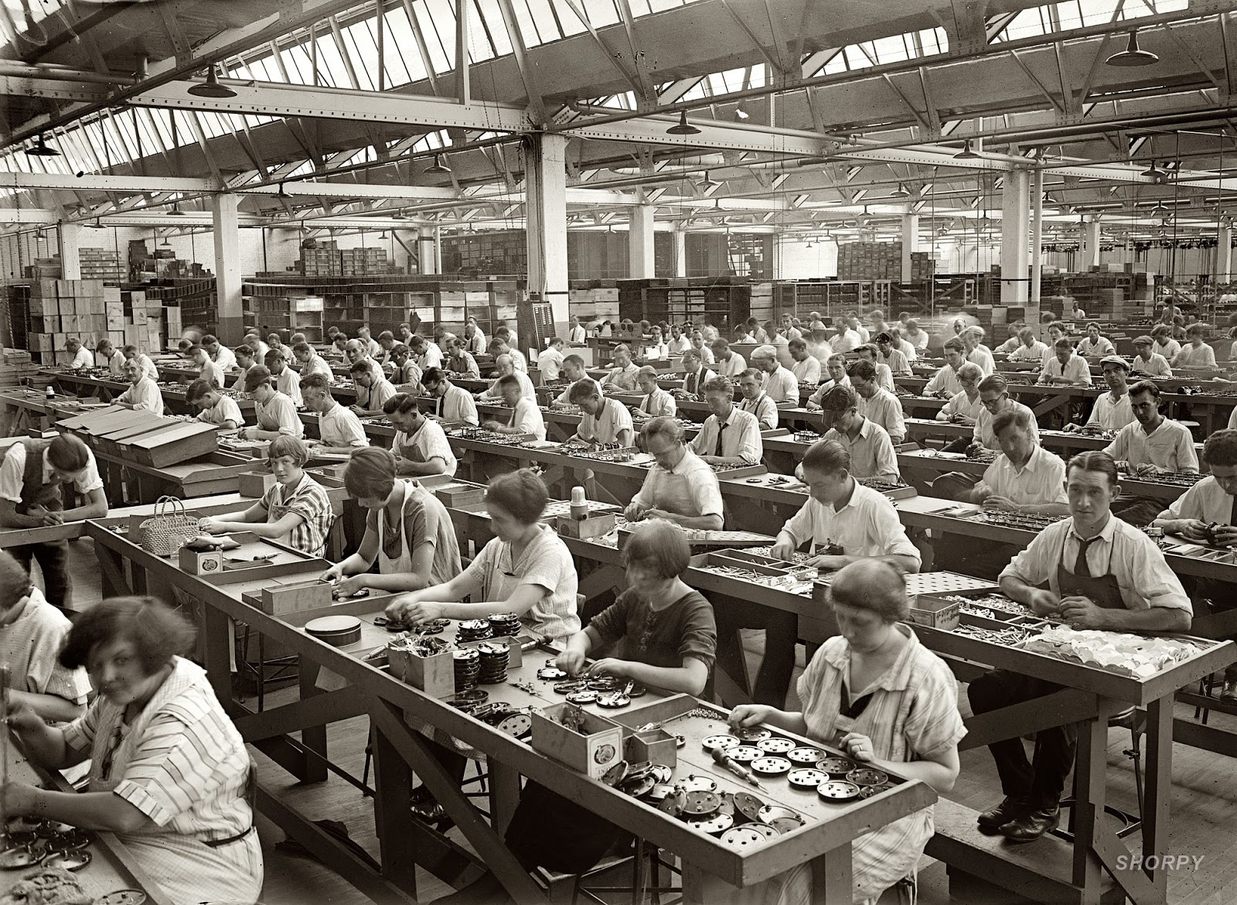
Miners
Optimizing: kWh /$ / ASIC Efficiency / Cooling / Labor / Demand Management Programs / Drying Fruit / Getting NatGas Credits / Outcompeting All Rivals
Full Node
Validating L1
+ counting to 13,150
+ add/remove/validate Sidechains

Slide 52
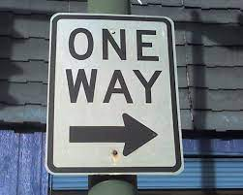
The “One Way Street”
Bip300 Drivechains
Layer 2
Bit-zCash
Bit-Monero
L2 node must have access to an L1 node
Drama
Centralization
Reorgs
Bad Design
Layer 1
Bitcoin Core
Notes:
Ok, aspect two – the base layer ( ie, Bitcoin Core, ie the mainchain, ie “layer1”) that – your Bitcoin node -- is unaffected by problems on the sidechain. Even under very extreme adversarial conditions where the sidechain experiencing all sorts of chaos, Layer1 is just going to solider on, and ignore all of that. The drama can only go one way. So, let me try to explain this.

Slide 53
The “One Way Street”
Bip300 Drivechains
Bit-zCash
Bit-Monero
Layer 2
Drama?
“I’m having a problem with my ring signatur---”
Drama
Centralization
Reorgs
Bad Design
Layer 1
Bitcoin Core
Notes:
Ok, aspect two – the base layer ( ie, Bitcoin Core, ie the mainchain, ie “layer1”) that – your Bitcoin node -- is unaffected by problems on the sidechain. Even under very extreme adversarial conditions where the sidechain experiencing all sorts of chaos, Layer1 is just going to solider on, and ignore all of that. The drama can only go one way. So, let me try to explain this.

Slide 54
The “One Way Street”
Bip300 Drivechains
Bit-zCash
Bit-Monero
Layer 2
Drama?
“I’m having a problem with my ring signatur---”
Drama
Centralization
Reorgs
Bad Design
Layer 1
Can’t hear you, sorry.
Bitcoin Core
Notes:
Ok, aspect two – the base layer ( ie, Bitcoin Core, ie the mainchain, ie “layer1”) that – your Bitcoin node -- is unaffected by problems on the sidechain. Even under very extreme adversarial conditions where the sidechain experiencing all sorts of chaos, Layer1 is just going to solider on, and ignore all of that. The drama can only go one way. So, let me try to explain this.

Slide 55
The “One Way Street”
Bip300 Drivechains
Bit-zCash
Bit-Monero
Layer 2
Drama?
Drama
Centralization
Reorgs
Bad Design
What’s that?? Oh Sorry can’t hear you. Enjoying my music over here.
Layer 1
Bitcoin Core
Notes:
Ok, aspect two – the base layer ( ie, Bitcoin Core, ie the mainchain, ie “layer1”) that – your Bitcoin node -- is unaffected by problems on the sidechain. Even under very extreme adversarial conditions where the sidechain experiencing all sorts of chaos, Layer1 is just going to solider on, and ignore all of that. The drama can only go one way. So, let me try to explain this.

Slide 56
Putting Hash(L2) into L1
= Block Header
= List of transactions
December 2020
January 2021
February 2021
March 2021
April 2021
Base Layer (Bitcoin Core)
Notes:
Here is a representation of Bitcoin’s blockchain. The squares are block headers, and the trailing rectangles are the list of transactions in each block. (Because blocks aren’t always the same size, of course.) And time is flowing from left to right. You can see across the top I’m going from Dec to April. Normally, of course, there would be tens of thousands of blocks (from Dec to April), that wouldn’t have FIT on the slides so there’s only seventeen. Now, what if there was a sidechain, activated, this whole time? Like a clone of Monero, or something. Well, we’ll put it up...

Slide 57
Putting Hash(L2) into L1
= Block Header
= List of transactions
December 2020
January 2021
February 2021
March 2021
April 2021
Layer 2 (Bit-Monero)
Base Layer (Bitcoin Core)
Notes:
Here it is. It has its own blocks, and its own block headers, and its own block chain, from December (on the left) to April (on the right). Now, the idea is ... that ...

Slide 58
Putting Hash(L2) into L1
= Block Header
= List of transactions
December 2020
January 2021
February 2021
March 2021
April 2021
Layer 2 (Bit-Monero)
e320
81cd
3 Months = One 32-byte Hash
3 Months = One 32-byte Hash
e320b6c2fffc8d750423db8b1eb942ae710e951ed797f7affc8892b0f1fc122b
81cd02ab7e569e8bcd9317e2fe99f2de44d49ab2b8851ba4a308000000000000
Base Layer (Bitcoin Core)
e320 ... Pays Out
Notes:
... Three months of sidechain activity are compressed into one little 64-character string here. And that string is the only thing inserted into Layer1. Ever. So, no matter what Bit-Monero over here is doing, this is all that layer1 will see.. ready ?

Slide 59
Your Layer 1 Node Sees…
Putting Hash(L2) into L1
Base Layer (Bitcoin Core)
e320b6c2fffc8d750423db8b1eb942ae710e951ed797f7affc8892b0f1fc122b
e320 ... Pays Out
81cd02ab7e569e8bcd9317e2fe99f2de44d49ab2b8851ba4a308000000000000
Notes:
This. Therefore, full nodes (on Layer1, down here in blue); they do not check anything that is happening on the sidechain (where there can be, theoretically, unlimited complexity). The sidechain doesn’t need to be a blockchain, it doesn’t need to be written in c++, it can make all kinds of mistakes. Etc. Bip300 operates entirely off of this one little string (here in green). (!) It does a lot of logic to that 4 little string, and assumptions and engineering, game theory economics, etc. I don’t have time to explain all of it. But the point is that Layer1 can’t be harmed by Layer2 because it really is ignoring Layer2. I feel compelled to drive this point even further, so...

Slide 60
But then how is it secure??

Slide 61
Miners
Optimizing: kWh /$ / ASIC Efficiency / Cooling / Labor / Demand Management Programs / Drying Fruit / Getting NatGas Credits / Outcompeting All Rivals
Full Node
Validating L1
+ counting to 13,150
+ add/remove/validate Sidechains

Slide 62
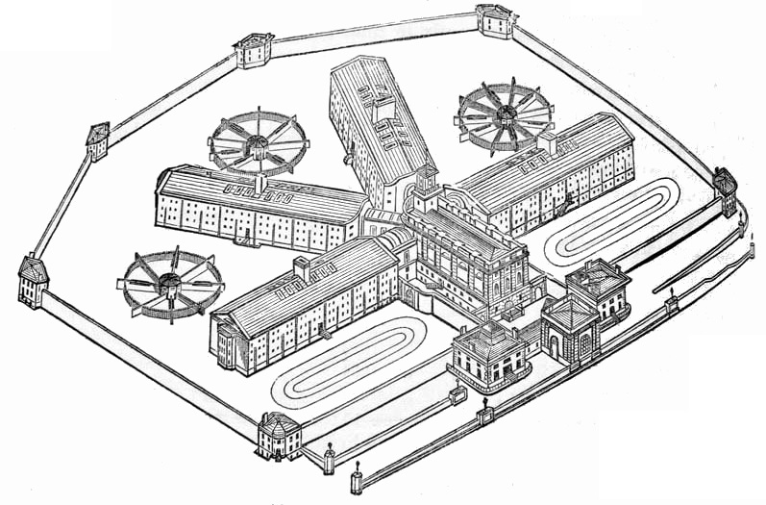
Prison Metaphor
Prison
BTC
…
Only way out.
13,150 Gates

Slide 63
Summary
Txn Fees
Token Value
Miners
e
New source of miner-profits.
Miners choice: claim this revenue, or destroy it.
High-Auditability:
Reducing “all txns” down to “net transfers”.
Crunching all xfers down to 32 bytes.
One transfer at a time.
Transfers take 3 months to settle.
Notes:
Earn money from running the prison.

Slide 64
Miners can already:
Steal from LN channels – by censoring the justice txn
Reorg mainchain Bitcoin txns out, and hold them hostage
Block any message from L1 – including zk-proofs
So, marginally, it is not actually very large an assumption.

Slide 65
6 - Two Critiques

Slide 66
Two Supposed Drawbacks
(#1) Miners-Can-Steal from Bip300 Scripts (and this is bad)
Hashrate
fixed
cost
0%
100%
(#2) Merged-Mining is a Side-Hustle (and those are bad)
eb942ae710e951ed797e320b6c2fffc8d750423db8b1f2b0f1fc122b7affc889
eb94 ... Pays Out
e320b6c2fffc8d750423db8b1eb942ae710e951ed797f7affc8892b0f1fc122b
Notes:
… Ok now for those *drawbacks*. Here they are. The first supposed drawback of Bip300, is that miners can ---with a little bit of setup and technical knowledge and effort on their part, and certainly patience--- miners can remove all the coins from a Bip300 sidechain, and pay those coins, to themselves. Hence it is called the “miners- can-steal” problem. Here you see an evil miner, replacing that one hash I mentioned before with a different hash, and then it eventually pays out (to the miner). The second, supposed drawback of Bip300, *sigh* is: if some miners ever have a profitable side- hustle, then maybe some other miners might not be able to have that side hustle. And then they might go out of business; and wouldn’t be able to buy as many Xmas presents for their children.

Slide 67
(#1) Miners-Can-Steal from Bip300 Scripts (and this is bad) | (#2) Merged-Mining is a Side-Hustle (and those are always bad)
The free market allows entrepreneurs to go bankrupt – this is an essential part of creativity. True: not every SC will succeed. But those few that do, will pay fees to miners and boost BTC’s appeal (since BTC can now easily do everything). The failures will serve as a warning to lazy or incompetent developers. | The fixed cost in question… …is zero under BMM. …was already microscopic, vs other miner fixed costs. …must always be small enough for non-mining nodes to exist (since their revenue is the smallest of all, $0.)
Bip300 has multiple safeguards in place to make “stealing” difficult. Stealing requires 3-6 months of openly dishonest mining activity. Humans can audit theft, by checking just 32 bytes. | Mining is a complex task involving many “sub-tasks” (getting cheap power / sourcing good ASICs / etc). Each has its own incentives, innovation, and fixed costs. No stopping those.
Miners “can” steal from Lightning Network (by broadcasting old state + censoring Justice Txns), but this criterion is never held against LN. | Bizarre implications: if BitFury sold t-shirts on the side, for profit, then t-shirts = bad for BTC. If Saylor altruistically paid miners $0.10 per year, then MS = bad for Bitcoin.
The user is sovereign. Users are allowed to sell their BTC for USD; or use BTC to buy “bad” products (ie “drugs”). Or invest in Alts / scams. Bip300 allows users to spend BTC to a script. | MM is the opposite of bad – it is good and necessary. MM alone can boost BTC’s fee revenues by 10,000x or more. Without MM, long run hashrate may be too low.
This supposed “flaw” is actually a pro, as it gives miners motive and opportunity to destroy “parasite sidechains” (SC which antagonize other SCs). I am not aware of any other way of efficiently accomplishing this. And I believe it is prerequisite for high-quality smart contracts. | What is probably happening is that people are confusing node costs with mining costs. Node costs *must* be low, for decentralization. But mining costs have no such requirement. In fact, if we wanted mining costs to be low we could remove the upward difficulty adjustments.
The whole point of SCs is that Layer1 nodes ignore them. With federations, you trust a fixed committee of law-abiding people. With BIp300 you trust a decentralized P2P process. | MM is already unblockable. Satoshi invented MM in 2010, and envisioned many independent MM chains. We have been MM since 2011, with no end in sight.
Notes:
Both of these are so, false, that its hard to know where to begin.

Slide 68
(#1) Miners-Can-Steal from Bip300 Scripts (and this is bad) | (#2) Merged-Mining is a Side-Hustle (and those are always bad)
The free market allows entrepreneurs to go bankrupt – this is an essential part of creativity. True: not every SC will succeed. But those few that do, will pay fees to miners and boost BTC’s appeal (since BTC can now easily do everything). The failures will serve as a warning to lazy or incompetent developers. | The fixed cost in question… …is zero under BMM. …was already microscopic, vs other miner fixed costs. …must always be small enough for non-mining nodes to exist (since their revenue is the smallest of all, $0.)
Bip300 has multiple safeguards in place to make “stealing” difficult. Stealing requires 3-6 months of openly dishonest mining activity. Humans can audit theft, by checking just 32 bytes. | Mining is a complex task involving many “sub-tasks” (getting cheap power / sourcing good ASICs / etc). Each has its own incentives, innovation, and fixed costs. No stopping those.
Miners “can” steal from Lightning Network (by broadcasting old state + censoring Justice Txns), but this criterion is never held against LN. | Bizarre implications: if BitFury sold t-shirts on the side, for profit, then t-shirts = bad for BTC. If Saylor altruistically paid miners $0.10 per year, then MS = bad for Bitcoin.
The user is sovereign. Users are allowed to sell their BTC for USD; or use BTC to buy “bad” products (ie “drugs”). Or invest in Alts / scams. Bip300 allows users to spend BTC to a script. | MM is the opposite of bad – it is good and necessary. MM alone can boost BTC’s fee revenues by 10,000x or more. Without MM, long run hashrate may be too low.
This supposed “flaw” is actually a pro, as it gives miners motive and opportunity to destroy “parasite sidechains” (SC which antagonize other SCs). I am not aware of any other way of efficiently accomplishing this. And I believe it is prerequisite for high-quality smart contracts. | What is probably happening is that people are confusing node costs with mining costs. Node costs *must* be low, for decentralization. But mining costs have no such requirement. In fact, if we wanted mining costs to be low we could remove the upward difficulty adjustments.
The whole point of SCs is that Layer1 nodes ignore them. With federations, you trust a fixed committee of law-abiding people. With BIp300 you trust a decentralized P2P process. | MM is already unblockable. Satoshi invented MM in 2010, and envisioned many independent MM chains. We have been MM since 2011, with no end in sight.
c
Notes:
So, Bip300 is designed, to prevent miners from stealing from sidechains. But, it is nonetheless possible. Similarly, – miners “can” (can in quotes **) steal from the LN. In fact its much easier for miners to steal from the LN, since Bip300 has this 6 month timeout period. So, were you worried about miners stealing from the lightning network a moment ago? If so, just cross off this entire left half of the page. I have to stress: this comparison isn’t to knock the LN, I’m saying that the criterion is stupid. 51% hashrate can do a lot of horrible things, but that doesn’t stop us from allowing users to opt-in to certain tradeoffs. After all, its Bitcoin not Prison.

Slide 69
(#1) Miners-Can-Steal from Bip300 Scripts (and this is bad) | (#2) Merged-Mining is a Side-Hustle (and those are always bad)
The free market allows entrepreneurs to go bankrupt – this is an essential part of creativity. True: not every SC will succeed. But those few that do, will pay fees to miners and boost BTC’s appeal (since BTC can now easily do everything). The failures will serve as a warning to lazy or incompetent developers. | The fixed cost in question… …is zero under BMM. …was already microscopic, vs other miner fixed costs. …must always be small enough for non-mining nodes to exist (since their revenue is the smallest of all, $0.)
Bip300 has multiple safeguards in place to make “stealing” difficult. Stealing requires 3-6 months of openly dishonest mining activity. Humans can audit theft, by checking just 32 bytes. | Mining is a complex task involving many “sub-tasks” (getting cheap power / sourcing good ASICs / etc). Each has its own incentives, innovation, and fixed costs. No stopping those.
Miners “can” steal from Lightning Network (by broadcasting old state + censoring Justice Txns), but this criterion is never held against LN. | Bizarre implications: if BitFury sold t-shirts on the side, for profit, then t-shirts = bad for BTC. If Saylor altruistically paid miners $0.10 per year, then MS = bad for Bitcoin.
The user is sovereign. Users are allowed to sell their BTC for USD; or use BTC to buy “bad” products (ie “drugs”). Or invest in Alts / scams. Bip300 allows users to spend BTC to a script. | MM is the opposite of bad – it is good and necessary. MM alone can boost BTC’s fee revenues by 10,000x or more. Without MM, long run hashrate may be too low.
This supposed “flaw” is actually a pro, as it gives miners motive and opportunity to destroy “parasite sidechains” (SC which antagonize other SCs). I am not aware of any other way of efficiently accomplishing this. And I believe it is prerequisite for high-quality smart contracts. | What is probably happening is that people are confusing node costs with mining costs. Node costs *must* be low, for decentralization. But mining costs have no such requirement. In fact, if we wanted mining costs to be low we could remove the upward difficulty adjustments.
The whole point of SCs is that Layer1 nodes ignore them. With federations, you trust a fixed committee of law-abiding people. With BIp300 you trust a decentralized P2P process. | MM is already unblockable. Satoshi invented MM in 2010, and envisioned many independent MM chains. We have been MM since 2011, with no end in sight.
Notes:
The second one is even sillier. I think what I would like to highlight is that the implications are ridiculous. So, if BitFury sold t-shirts on the side, for profit, then t-shirts = bad for BTC. They would be as bad for Bitcoin as Bip300 is, anyway. If Michal Saylor altruistically paid miners $0.10 per year, then MS = bad for 9 Bitcoin. Blah blah blah... I think what’s really happening here, is that people are confusing nodes with miners. Miners run nodes, but not the other way around. We want nodes to be as cheap as possible. That is absolutely important; but we don’t want mining to be as cheap as possible. If we wanted that, we could just get rid of all of the upward difficulty adjustments. So I have total contempt for these two supposed drawbacks. In fact both of them are not drawbacks at all…

Slide 70
(#1) Miners-Can-Steal from Bip300 Scripts (and this is bad) | (#2) Merged-Mining is a Side-Hustle (and those are always bad)
The free market allows entrepreneurs to go bankrupt – this is an essential part of creativity. True: not every SC will succeed. But those few that do, will pay fees to miners and boost BTC’s appeal (since BTC can now easily do everything). The failures will serve as a warning to lazy or incompetent developers. | The fixed cost in question… …is zero under BMM. …was already microscopic, vs other miner fixed costs. …must always be small enough for non-mining nodes to exist (since their revenue is the smallest of all, $0.)
Bip300 has multiple safeguards in place to make “stealing” difficult. Stealing requires 3-6 months of openly dishonest mining activity. Humans can audit theft, by checking just 32 bytes. | Mining is a complex task involving many “sub-tasks” (getting cheap power / sourcing good ASICs / etc). Each has its own incentives, innovation, and fixed costs. No stopping those.
Miners “can” steal from Lightning Network (by broadcasting old state + censoring Justice Txns), but this criterion is never held against LN. | Bizarre implications: if BitFury sold t-shirts on the side, for profit, then t-shirts = bad for BTC. If Saylor altruistically paid miners $0.10 per year, then MS = bad for Bitcoin.
The user is sovereign. Users are allowed to sell their BTC for USD; or use BTC to buy “bad” products (ie “drugs”). Or invest in Alts / scams. Bip300 allows users to spend BTC to a script. | MM is the opposite of bad – it is good and necessary. MM alone can boost BTC’s fee revenues by 10,000x or more. Without MM, long run hashrate may be too low.
This supposed “flaw” is actually a pro, as it gives miners motive and opportunity to destroy “parasite sidechains” (SC which antagonize other SCs). I am not aware of any other way of efficiently accomplishing this. And I believe it is prerequisite for high-quality smart contracts. | What is probably happening is that people are confusing node costs with mining costs. Node costs *must* be low, for decentralization. But mining costs have no such requirement. In fact, if we wanted mining costs to be low we could remove the upward difficulty adjustments.
The whole point of SCs is that Layer1 nodes ignore them. With federations, you trust a fixed committee of law-abiding people. With BIp300 you trust a decentralized P2P process. | MM is already unblockable. Satoshi invented MM in 2010, and envisioned many independent MM chains. We have been MM since 2011, with no end in sight.
Notes:
… the left one allows for super-reliable oracle and high-quality smart contracts, and the right one is the only thing that is going to keep hashrate security up, in the future. So, they’re not drawbacks at all, in fact they’re both pretty cool; features.

Slide 71
Why Hasn’t Bitcoin Already Conquered the World?
Time
2009 | 2011 | 2013 | 2015 | 2017 | 2019 | 2021 | 2023
Initial Growth P
Blocksize War
Today
Orthodox Interpretation
Network-Effect Interpretation

Slide 72
Why Hasn’t Bitcoin Already Conquered the World?
Time
2009 | 2011 | 2013 | 2015 | 2017 | 2019 | 2021 | 2023
Initial Growth P
Blocksize War
Today
It takes time!
S**tcoins exist because of moral defects (“greed”, scams, bad marketing).
Culling of the Weak
Unreliable allies were purged
Demonstrates our Commitment to Decentralization
Orthodox Interpretation
Network-Effect Interpretation

Slide 73
Why Hasn’t Bitcoin Already Conquered the World?
Time
2009 | 2011 | 2013 | 2015 | 2017 | 2019 | 2021 | 2023
Initial Growth P
Blocksize War
Today
It takes time!
S**tcoins exist because of moral defects (“greed”, scams, bad marketing).
Culling of the Weak
Unreliable allies were purged
Demonstrates our Commitment to Decentralization
Orthodox Interpretation
Complacency / Flippening / Uncertainty that Bitcoin is “the one”.
People like the features and cheap fees of other blockchains.
Network-Effect Interpretation
Community no longer a welcoming / pro-growth place.
Gave pretext / justification to Ethereum / other competitors.
Demonstrates our abandoning our core mission (world domination, “bitcoin vs the banks”), so that we can play internal political games amongst ourselves.

Slide 74
How to Get These BIPs

Slide 75
Soft Fork Deadlock Problem
Bitcoin Development has slowed to a crawl – because of 2017!
Year | 2010 | 2011 | 2012 | 2013 | 2014 | 2015 | 2016
# of Soft Forks | 7 | 0 | 2 | 2 | 0 | 2 | 3
16
Year | 2017 | 2018 | 2019 | 2020 | 2021 | 2022 | 2023
# of Soft Forks | 1 | 0 | 0 | 0 | 1 | 0 | 0 (Presumably)
2
SegWit
Announced Dec 2015
Coded Oct 2016
Activated Aug 2017
Taproot
Announced Jan 2018
Coded Oct 2020
Activated Nov 2021
20 Months
46 Months

Slide 76
Modern Soft Fork Activation
The fate of 118
The fate of 119
If we always refuse to act, out of fear of making an error – that itself is a pretty grave error.
If we always defer – it will create politics and chaos.
Miners must get involved and learn the issues.
Not everyone can be a specialist – by definition. But you can force 2-3 independent specialists to compete for your attention.

Slide 77
How to Get BIPs 300/301
Specifically, SoftFork deadlock problem – 2017-era Miners created this problem, can be solved with leadership from >50% hashpower (a few pools). Can be solved once-and-for-all.
Requires better Pool ←→ Hasher communication. And willingness to switch pools. Or even punitively destroy a pool, retroactively.
Someone has to take responsibility – and its YOU! Long run, you will suffer the most… if Bitcoin underperforms.

Slide 78
Supporters and Detractors
 | Supporters | Detractors
Theorists | Many Tech Elite ( visit LayerTwoLabs.com/friends ) | Hopelessly Confused The main concern is Billions of Revenue, may cost miners $40k , which may harm small miners. (None of that is true.)
Builders | Reluctant Altcoiners ETH, Monero, BCH, Namecoin, Sia – all created by Bitcoiners. Published comments of regret, re Bitcoin’s non-extensibility All will be cloned, by me! So we will steal back their work. | The Death Cult Unwilling to give Altcoins any credit for innovation. Or adoption. Think Bitcoin shouldn’t improve / can’t improve (since it is perfect). Prefer Bitcoin to stay niche.

Slide 79
In One Slide
More revenues ( 10x 20x ) are possible, but only if Miners educate themselves on the tech. Including conflicts-of-interest among dev groups.
What are BIPs 300/301 ?
300 allows for conversion: [ Altcoin L1 ] → [ BTC-only L2 ] .
301 allows Bitcoin miners (that’s you), to collect all the fees of these networks.
Requires 51% hashrate to activate soft fork + other very small costs.
How to get it ?
Miners take responsibility for educating self on BIPs.
Fix softfork deadlock issue. Force responsibility onto someone.
Fix Pool – Hasher communication.
Notes:
… so, by all means, go back to whatever you were doing before and don’t listen to this talk.

Slide 80
Detractors
The Hopelessly Confused Believe misinformation about the idea. For example, Peter Todd mistakenly believes that this idea could cost miners as much as $40k / year in software, which he says may harm small miners. (Not true. But also irrelevant since every mining input has fixed/variable costs.) | The Death Cult People who: Think Bitcoin shouldn’t improve / can’t improve (since it is perfect). Think Bitcoin shouldn’t compete / doesn’t compete for users (since it is perfect). Are uninterested in long run miner revenues. Are unwilling to give Altcoins any credit for innovation. Or adoption. Prefer Bitcoin to stay niche.

Slide 81
Conflicts of Interest – Time to get Woke
Devs , Users, Miners, Investors

Slide 82
Good Luck with Your Decision!
@truthcoin on twitter
@psztorc on Telegram
I know many Pools/Miners, also can contact me through them.

