Slide 1
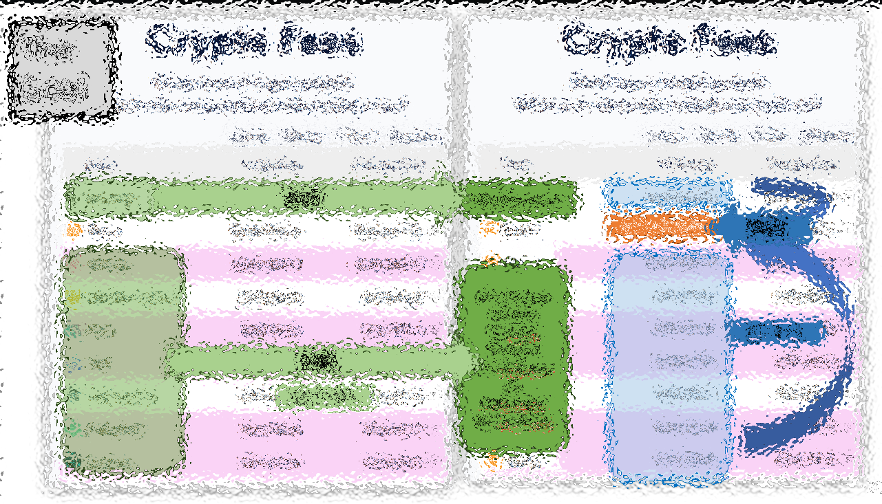
BIP 300/301 – Collecting every txn fee on Earth
Paul Sztorc
Nov 17, 2023 North American Blockchain Summit

Slide 2
In One Slide
Paul Sztorc (me), author of BIPs 300/301 …
… I’m saying that you (Miners), can earn Billions more revenues…
…if you do the right thing, which is: become more educated on technical issues.
BIPs 300/301 …
… 300: Altcoin txns → BTC txns …
… 301: gives all those txn fees to you (the L1 Bitcoin miners).
Other benefits and details.
How to Get It
Easy! 51% Hashrate updates.
But, it is a touchy subject. You must research the issues.
Warning – fail to act, and there may be future mismatch between L1/L2 fees.

Slide 3
When Worlds Collide…
Notes:
The mining world, and the Software world are going to collide…
… now, this doesn’t happen very often. I mean this is my perception … perhaps you disagree…
(Here is the Miami Beach Convention Center, the big Bitcoin conference…) … and here you see that they keep our two groups very far apart, mostly. Not very many people crossover.

Slide 4
When Worlds Collide…
Notes:
The mining world, and the Software world are going to collide…
… now, this doesn’t happen very often. I mean this is my perception … perhaps you disagree…
(Here is the Miami Beach Convention Center, the big Bitcoin conference…) … and here you see that they keep our two groups very far apart, mostly. Not very many people crossover.

Slide 5
When Worlds Collide…
Notes:
The mining world, and the Software world are going to collide…
… now, this doesn’t happen very often. I mean this is my perception … perhaps you disagree…
(Here is the Miami Beach Convention Center, the big Bitcoin conference…) … and here you see that they keep our two groups very far apart, mostly. Not very many people crossover.

Slide 6
My 1000+ Pages About Bitcoin
2012-2014 | Statistician, Yale Econ → Bitcoin Researcher
Notes:
Before I was a CEO, I described myself as a Bitcoin Researcher.

Slide 7
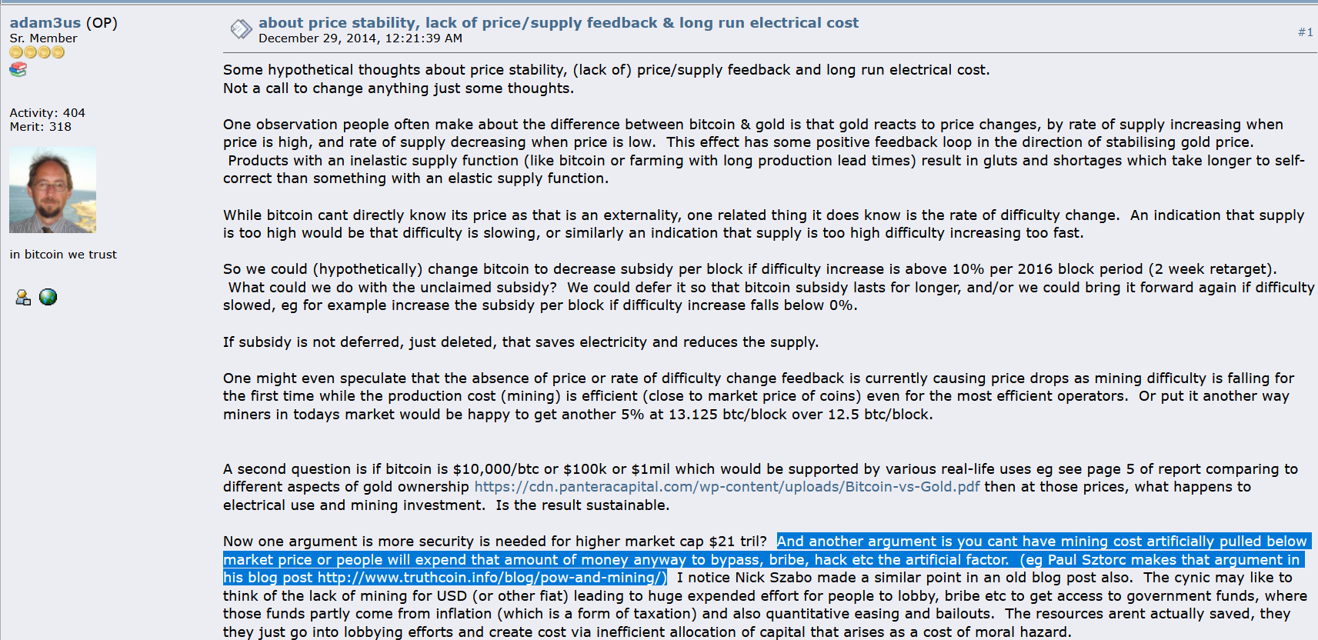
My Big Break
Dec 2014 – Adam Back links to my blog

Slide 8
Since Then…
2013/2014 -- wrote code/whitepaper for P2P oracle (BitcoinHivemind.com)
Technical Talks
Scaling Bitcoin 1 2 & 3 -- Program Committee for #4
TabConf every year – keynoted in 2018
BitDevs – Summer 2014 (NYC), Austin (May 2018)
Bitcoin Wednesday – all around the globe (Toronto, Chicago, Amsterdam, etc)
Consensus Construct (2017, 2019); American Banker ; Qcon London (2017)
Bitcoin Miami 2019/2021/2022/2023 & Amsterdam (all years)
Countless podcasts, spaces, etc.
Wrote BIPs 300 and 301.
Raised $3M to start LayerTwo Labs & help Bitcoiners dominate the world.
Notes:
, since, frankly, no one else was doing it.

Slide 9
Part 2 – BIP 300/301 (also called “Drivechain”)
The idea
Timeline of Progress
Supporters / Detractors
More details

Slide 10
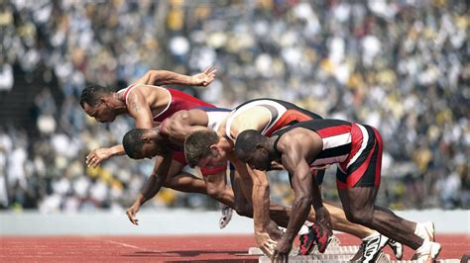
Goals of BIP 300/301
Every transaction, in the world, is a Bitcoin txn, and each contributes to miner-revenues.
There are many different Bitcoin Networks, to accommodate different people /usecases.
Competition among networks/devs, ie – they all hate each other.
Layer 2
Layer 1
All the world’s txns are already on some network or another. They all pay some kind of fee to someone. (VISA, Venmo)
Notes:
That’s right, I’m pro-hate. Because I’m pro-competition. The more they hate each other, the harder they will work for the user.
More users → more transaction fees, and a higher price of Bitcoin.

Slide 11
Goals of BIP 300/301
Every transaction, in the world, is a Bitcoin txn, and each contributes to miner-revenues.
There are many different Bitcoin Networks, to accommodate different people /usecases.
Competition among networks/devs, ie – they all hate each other.
BIP 300
BIP 301
Layer 2
Layer 1
All the world’s txns are already on some network or another. They all pay some kind of fee to someone. (VISA, Venmo)
Notes:
That’s right, I’m pro-hate. Because I’m pro-competition. The more they hate each other, the harder they will work for the user.
More users → more transaction fees, and a higher price of Bitcoin.

Slide 12
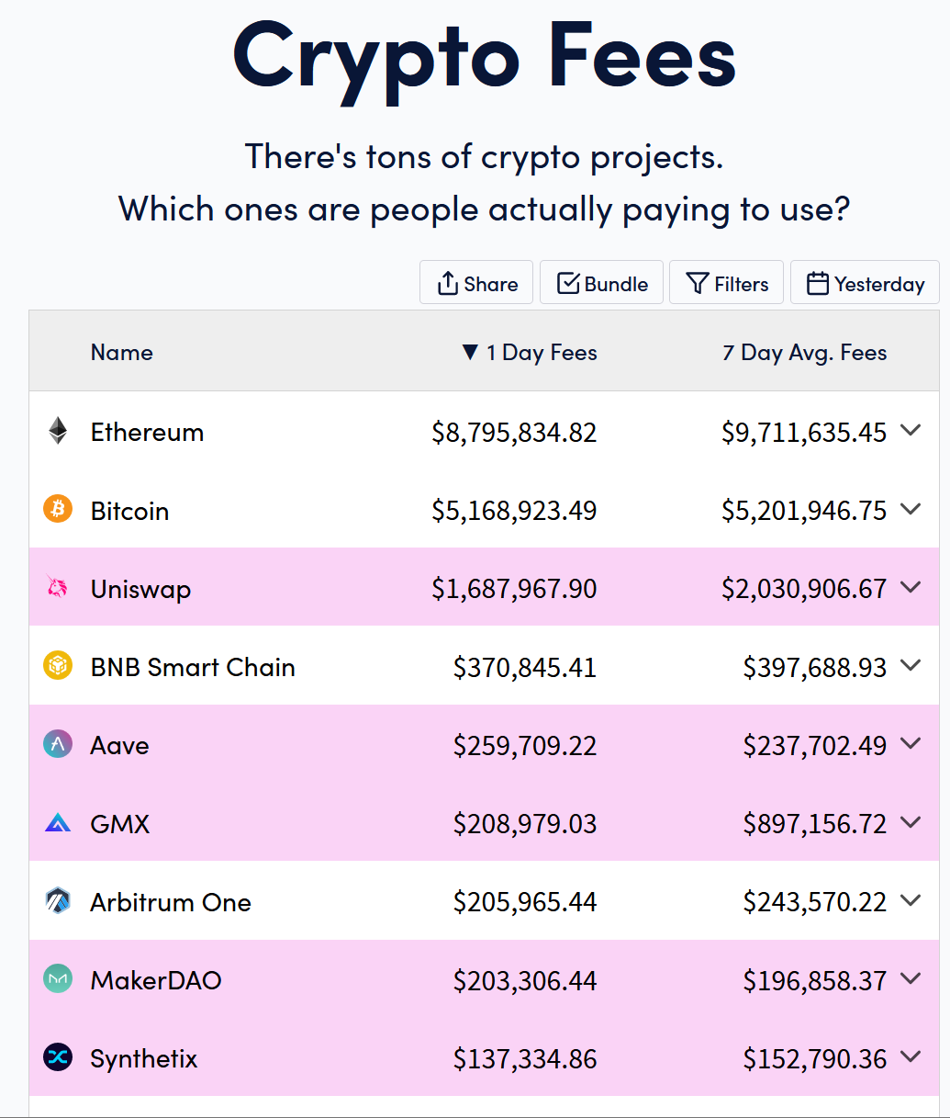
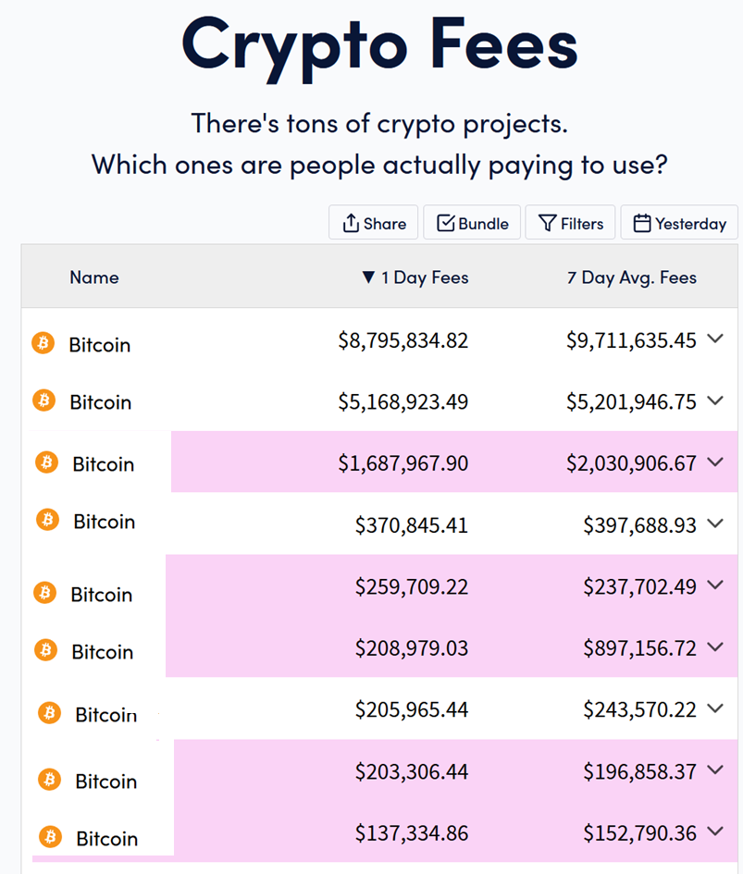
The Goal
$17,000,000
Notes:
Ok – I have an image for you.

Slide 13
The Goal
300
Bit-Ethereum
301
$17,000,000
Bit-Uniswap Bit-BNC Bit-Aave Bit-GMX Bit-Arbitrum Bit-MakerDAO Bit-Synthetix
L2 → L1
300
Alt → BTC
Notes:
Ok – I have an image for you.

Slide 14
Not limited to Existing Altcoins
Can include other networks, including centralized ones.
Or new blockchain networks we build from scratch.
Earth’s 1.1 trillion txns
At $0.10 = $100B per year in revenue. From payments alone.
Doubles roughly every ~ 5 years.
Chase revenues, instead of cutting costs.
More users = more Bitcoin adoption = higher price.
Notes:
As you will see, it doesn’t matter that it’s napkin math because the numbers are favorable to say the least.

Slide 15
The Cost
Activate BIP 300 – I’ll get to that.
Curate the portfolio of sidechains – very easy, since you have all the leverage. Cost ~$0.
Moderate disputes.
Run a node if there is a dispute.
Nodes are cheap, by mining standards. Worst-of-the-worst: Solana, BSV, 1 GB Blocksize node. Cost is 3k-5k $/year , each.
Amortized, 10 days to sync → $137 per dispute.
E(d) = 0
Miners can defer to pools ; pool admits can defer to a user’s node.
So cost = $0.
9 of those (or something better), would process the world’s txns. See my blog post “thunder” for details.
Notes:
As you will see, it doesn’t matter that it’s napkin math because the numbers are favorable to say the least.

Slide 16
The Cost
Activate BIP 300 – I’ll get to that.
Curate the portfolio of sidechains – very easy, since you have all the leverage. Cost ~$0.
Moderate disputes.
Run a node if there is a dispute.
Nodes are cheap, by mining standards. Worst-of-the-worst: Solana, BSV, 1 GB Blocksize node. Cost is 3k-5k $/year , each.
Amortized, 10 days to sync → $137 per dispute.
E(d) = 0
Miners can defer to pools ; pool admits can defer to a user’s node.
So cost = $0.
9 of those (or something better), would process the world’s txns. See my blog post “thunder” for details.
Notes:
As you will see, it doesn’t matter that it’s napkin math because the numbers are favorable to say the least.

Slide 17
Timeline of Progress
Timeline:
2015 – A mere blog post 2017 – BIP #s 300 / 301
2019 – 1st Software Release (testnet) 2022 – Cloned zCash and Eth.
2023 – Luke Dashjr’s WIP pull request to Bitcoin Core
Highly endorsed by the technical elite – but not everyone.

Slide 18
My Three Favorite Endorsements
"Drivechains…are pretty cool…and arguably could have been more important or useful than let’s say Taproot.“ - Adam Back, Baltic Honeybadger 2022, Live on stage in front of everyone
“We need Drivechain or all the work of thousands in the last 13 years will be in vain.” ... “Drivechain is our only hope”. - fiatjaf, (creator of nostr), on twitter
“We need your project, of course, for the obvious reasons...” - Rene Pickhardt ( Author of Mastering Lightning , #1 stackoverflow (?) contributor for LN questions ), MIT Bitcoin Expo, 2023
Visit www.LayerTwoLabs.com/friends for 49 more!
Notes:
These people all *Lead* a different project. Adam Back leads Blockstream and thus indirectly Liquid. Fiatjaf leads nostr. Rene is one of the leaders of LN.
Yet they all found some nice things to say about my project.
What can I say, kids – real respects real.

Slide 19
My Three Favorite Endorsements
"Drivechains…are pretty cool…and arguably could have been more important or useful than let’s say Taproot.“ - Adam Back, Baltic Honeybadger 2022, Live on stage in front of everyone
“We need Drivechain or all the work of thousands in the last 13 years will be in vain.” ... “Drivechain is our only hope”. - fiatjaf, (creator of nostr), on twitter
“We need your project, of course, for the obvious reasons...” - Rene Pickhardt ( Author of Mastering Lightning , #1 stackoverflow (?) contributor for LN questions ), MIT Bitcoin Expo, 2023
-Robin Linus, Founder of ZeroSync, Creator of BitVM / BitStream
Visit www.LayerTwoLabs.com/friends for 49 more!
Notes:
These people all *Lead* a different project. Adam Back leads Blockstream and thus indirectly Liquid. Fiatjaf leads nostr. Rene is one of the leaders of LN.
Yet they all found some nice things to say about my project.
What can I say, kids – real respects real.

Slide 20
Detractors
The Hopelessly Confused Believe misinformation about the idea. For example, Peter Todd mistakenly believes that this idea could cost miners as much as $40k / year in software, which he says may harm small miners. (Not true. But also irrelevant since every mining input has fixed/variable costs.) | The Death Cult People who: Think Bitcoin shouldn’t improve / can’t improve (since it is perfect). Think Bitcoin shouldn’t compete / doesn’t compete for users (since it is perfect). Are uninterested in long run miner revenues. Are unwilling to give Altcoins any credit for innovation. Or adoption. Prefer Bitcoin to stay niche.

Slide 21
A Bold Claim
BIP300 Solves All of Bitcoin’s Biggest Problems
Heterogeneity Problem
Scalability
Privacy
Scams – Eliminating ScamCoins ; Domesticating the Token Casino
Security Budget
Decentralization
“Fundamental Value” of Bitcoin
With...
...zero risk to Bitcoin!

Slide 22
That “Zero Risk” Part
Bip300 is an easy soft fork to add to Bitcoin... And an easy soft fork to remove.
Bitcoin Core v25
BIP 300 Softfork
New Bitcoin Core
Interoperable with Core v25
A Softfork Banning all Bip300 Deposits/Withdrawals from L1
Bitcoin Core v25
New Bitcoin Core
Interoperable with Core v25
So, worst case scenario, miners just run a simple softfork, and we are exactly back to where we are today.

Slide 23
A Bold Claim
Different strokes for different folks. Flexibility to grow and change as needed.
BIP300 Solves All of Bitcoin’s Biggest Problems
Heterogeneity Problem
Scalability
Privacy
Scams – Eliminating ScamCoins ; Domesticating the Token Casino
Security Budget
Decentralization
“Fundamental Value” of Bitcoin
With...
...zero risk to Bitcoin!
Different chains for different users.
A team of region-specific chains, each with a large growing Blocksize – onboard users directly to L2.
zCash drivechain.
Have a dedicated NFT/ERC/Ordinals chain. Pay all txn fees in BTC. Clear coin roles.
Merged Mining = miners collect ALL fees from ALL chains. For free.
Shrink L1 Bitcoin Core Blocksize, and ossify (the spec at least). No more politics.
Chains are actually useful for real world tasks.
BitNames + Truthcoin ; examples

Slide 24
A. Heterogeneity
Smart Contracts DeFi Turing Completeness Ring Signatures zk-Snarks Large Blocksizes
NFTs Oracles
Mimblewimble
…(etc)
Bitcoin does seem great… but can it do _______ ?
Actually we DON’T want Bitcoin to do ______ in the first place because it is actually a bad due to _______, as you can read ______. But if by ______ you really mean ______, then yes Bitcoin can do that! Eventually we are working on _____ which should be able to do ______ even better than ______ anyway but it is actually a good thing that the protocol is so difficult to upgrade beca …
Yes. See BIP 300.
Noob
Bitcoiner
Notes:
Ideally, with Bip300, if some annoying person asks “Sure Bitcoin seems great, but can it do .... smart_contracts, DeFI, zk-snarks, blah blah, you just say “Yes, Bitcoin can do that – see Bip300”.

Slide 25
A. Heterogeneity
I can improve Bitcoin! It only needs my new idea: _______ !! When can you merge my code ??
You can’t just merge something into Bitcoin -- It affects everyone else’s nodes!! Besides, ______ has been proposed before and you need to read ______ so that you can learn why everyone hates it, especially our infallible _______ who would have done it by now if it were a good idea. ________ is a SCAM and you are trying to ATTACK BITCOIN!! Even if your idea was good it would probably take years to get consensus and get merged into …
Noob (and/or Fringe Genius)
Use BIP 300.
Good luck!!
Bitcoiner
Notes:
Similarly, if some innovator dreams up a crazy idea, “Hey I can improve Bitcoin, it only needs my new idea ... larger blocksizes, Turing Completeness, KYC-miner-coins?” Then: similarly, they now can do that without anyone’s permission. They just don’t do it on Bitcoin base layer, they do it on a Bip300 sidechain.
So: that’s the goal – FREEDOM. Developers can write whatever code they want, users can use that code if they like. Everyone gets what they want. But how is it accomplished?

Slide 26
A Bold Claim
BIP300 Solves All of Bitcoin’s Biggest Problems
Heterogeneity Problem
Scalability
Privacy
Scams – Eliminating ScamCoins ; Domesticating the Token Casino
Security Budget
Decentralization
“Fundamental Value” of Bitcoin
With...
...zero risk to Bitcoin!
Different chains for different users.
A team of region-specific chains, each with a large growing Blocksize – onboard users directly to L2.
zCash drivechain.
Have a dedicated NFT/ERC/Ordinals chain. Pay all txn fees in BTC. Clear coin roles.
Merged Mining = miners collect ALL fees from ALL chains. For free.
Shrink L1 Bitcoin Core Blocksize, and ossify (the spec at least). No more politics.
Chains are actually useful for real world tasks.
BitNames + Truthcoin ; examples
Notes:
We don’t have time for all of these, but in the Q&A perhaps we can get back to them. However, I will go deeper into

Slide 27
LargeBlocks?? What about Decentralization??
A Scalability Paradigm Shift
Remember: Heterogeneity! People are different! “Coffee txn” does not need as much decentralization as other txns. Bitcoin must compete, today, with Venmo.

Slide 28
How to Get These BIPs

Slide 29
Soft Fork Deadlock Problem
Bitcoin Development has slowed to a crawl – because of 2017!
Year | 2010 | 2011 | 2012 | 2013 | 2014 | 2015 | 2016
# of Soft Forks | 7 | 0 | 2 | 2 | 0 | 2 | 3
16
Year | 2017 | 2018 | 2019 | 2020 | 2021 | 2022 | 2023
# of Soft Forks | 1 | 0 | 0 | 0 | 1 | 0 | 0 (Presumably)
2
SegWit
Announced Dec 2015
Coded Oct 2016
Activated Aug 2017
Taproot
Announced Jan 2018
Coded Oct 2020
Activated Nov 2021
20 Months
46 Months

Slide 30
Modern Soft Fork Activation
The fate of 118
The fate of 119
If we always refuse to act, out of fear of making an error – that itself is a pretty grave error.
If we always defer – it will create politics and chaos.
Miners must get involved and learn the issues.
Not everyone can be a specialist – by definition. But you can force 2-3 independent specialists to compete for your attention.

Slide 31
How to Get BIPs 300/301
Specifically, SoftFork deadlock problem – 2017-era Miners created this problem, can be solved with leadership from >50% hashpower (a few pools). Can be solved once-and-for-all.
Requires better Pool ←→ Hasher communication. And willingness to switch pools. Or even punitively destroy a pool, retroactively.
Someone has to take responsibility – and its YOU! Long run, you will suffer the most… if Bitcoin underperforms.

Slide 32
Thank You For Your Attention

Slide 33
Fundamental Value – Namecoin
Satoshi co-invents Namecoin in 2010
Why does today’s internet suck so much??
Namecoin Enables:
One Username – Own a single username, that works everywhere, on every site.
No more passwords! -- Login by being “pinged” with PIN via open protocol.
Easy to keep different online identities separate.
“PayMail” – Special inbox where people must pay you $ in order for the message to go through.
PayMail for introductions + Whitelists = eliminates all spam from the internet. This breaks the chokehold of Google.
On-chain PayMail is completely, 100% untraceable if you run a full node. No TOR required.
Everyone has end-to-end encryption. Everyone has a TOR / i2p website.
No seizing of ICANN domain names.
(Through Bip47 / similar), eliminates the need for Bitcoin addresses.
Notes:
In other words, Satoshi would have an email address, a zCash address, and an Instagram account and a TikTok, automatically.

Slide 34
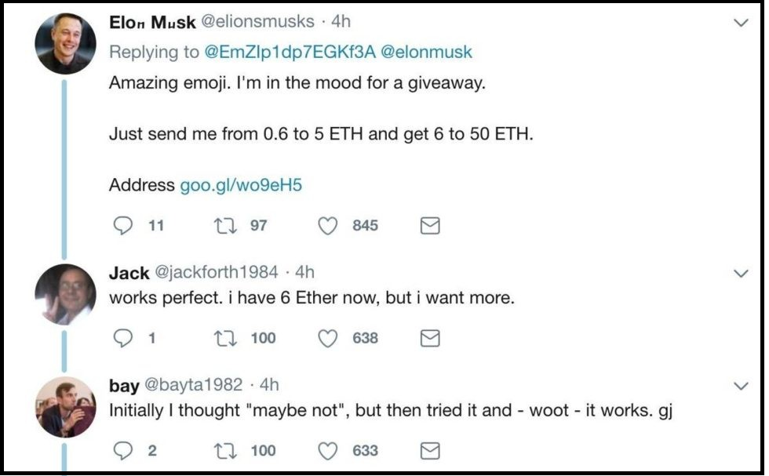
Screenshot #1 from www.truthcoin.info/blog/bitnames/
Notes:
…this is someone pretending to be Elon Musk, on Twitter…

Slide 35
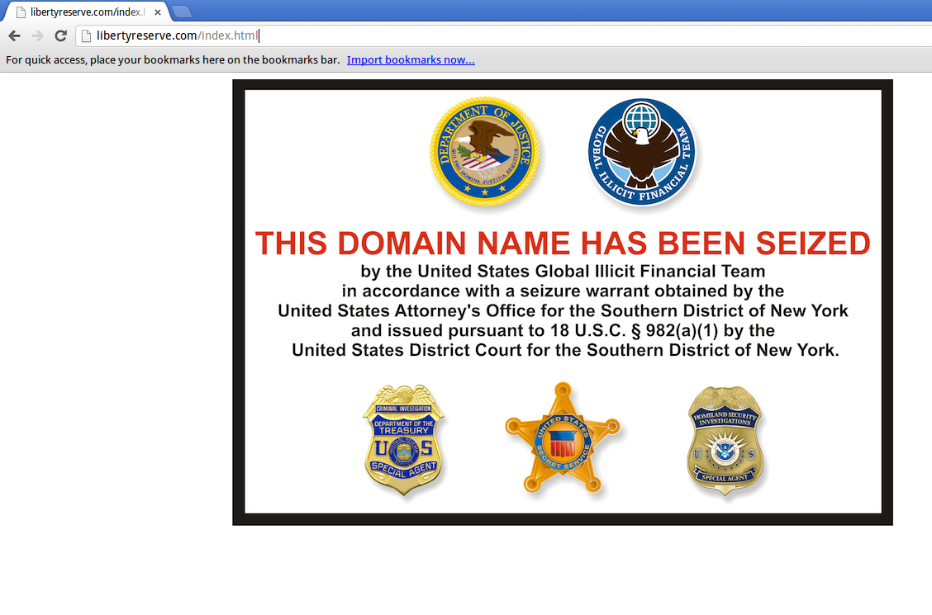
Screenshot #2 from www.truthcoin.info/blog/bitnames/
Notes:
…this is the Liberty Reserve website domain_name being seized…

Slide 36
Screenshot #3 from www.truthcoin.info/blog/bitnames/
Notes:
…this is a guy on YouTube who, in the bottom-right, has to list out all of his screennames ... and they aren’t all identical, his Facebook name is different. With BitDNS everyone would just have one login, for every service. No one could seize your account, anywhere. And people would always be able to find you.

Slide 37
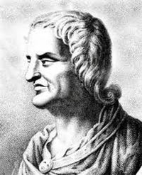
Fundamental Value – Truthcoin
Paul (me) invents Truthcoin in 2013/14
Why does today’s internet suck so much??
Truthcoin Enables:
Prediction Markets – prevents politicians/CEOs from lying.
Prevents politicians/CEOs from lying
Each voter/shareholder/whatever can become optimally informed, with zero effort.
Will counteract “rational ignorance” and Caplan-esque “rational irrationality”.
Eliminates the entire “misinformation” pipeline / food chain. (Lobbyists, pollsters, etc).
Thus, politicians will have to work as hard as possible.
Fork futures -- would have prevented the Blocksize war.
Portfolio replication – allows for stablecoins/anything-coins... no backer needed!
Paves the way for land-value-Futarchy / nirvana.
Quis custodiet ipsos custodes? – “But who is in charge of those who are in charge?”
Notes:
In other words, Satoshi would have an email address, a zCash address, and an Instagram account and a TikTok, automatically.

Slide 38
Rot From Above: Who controls what?
Informed or otherwise…
CEO / President / Senator / Editor-in-Chief
Group Opinion
C-Suite / Cabinet /
Coordinators / Reviewers
Managers / Directors /
Aides / Researchers
Shareholders /
Voters / Colleagues
Staff / Research Assistants
Result
Satisfaction of: Customers / Citizens / Readers

Slide 39
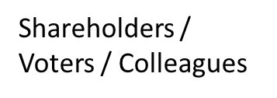
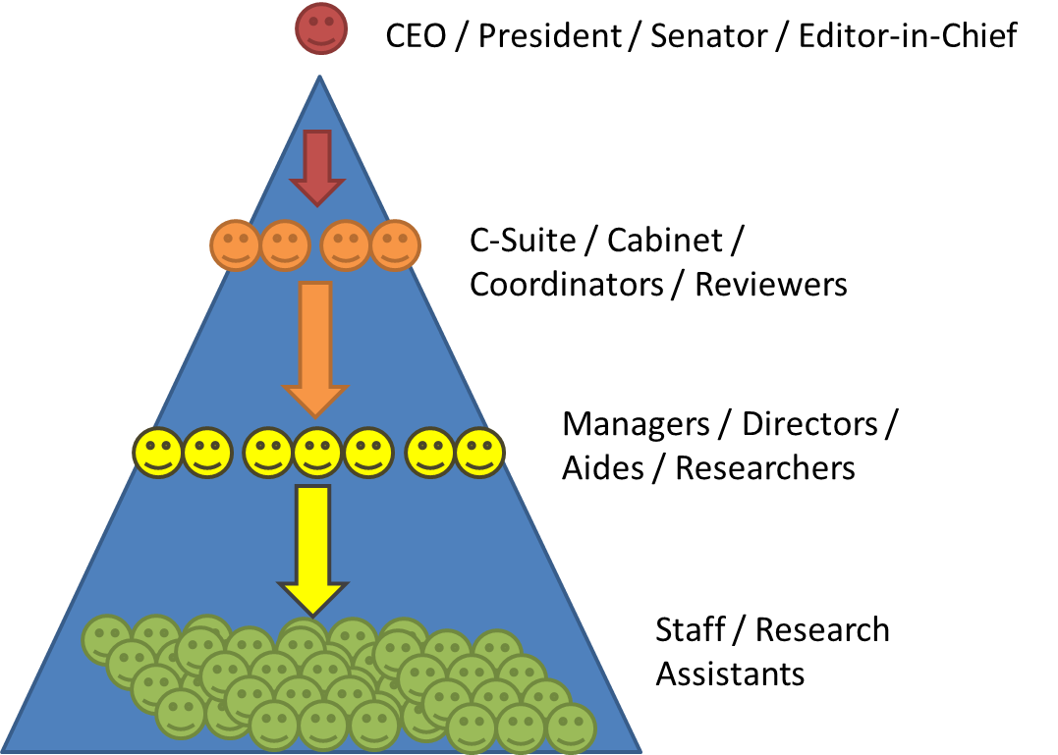
How to we combine the many preferences of this group into one request?
Do we each have to monitor the leader’s work? If not, who do we trust (and why)?
If I don’t like this leader, how do I find out if others agree? How do we fire the leader?
Bad
Prediction Markets fix this.
Can easily…
…make requests.
…observe work/results.
…fire insubordinates.
Good
Quis custodiet ipsos custodes? – “But who is in charge of those who are in charge?”

Slide 40
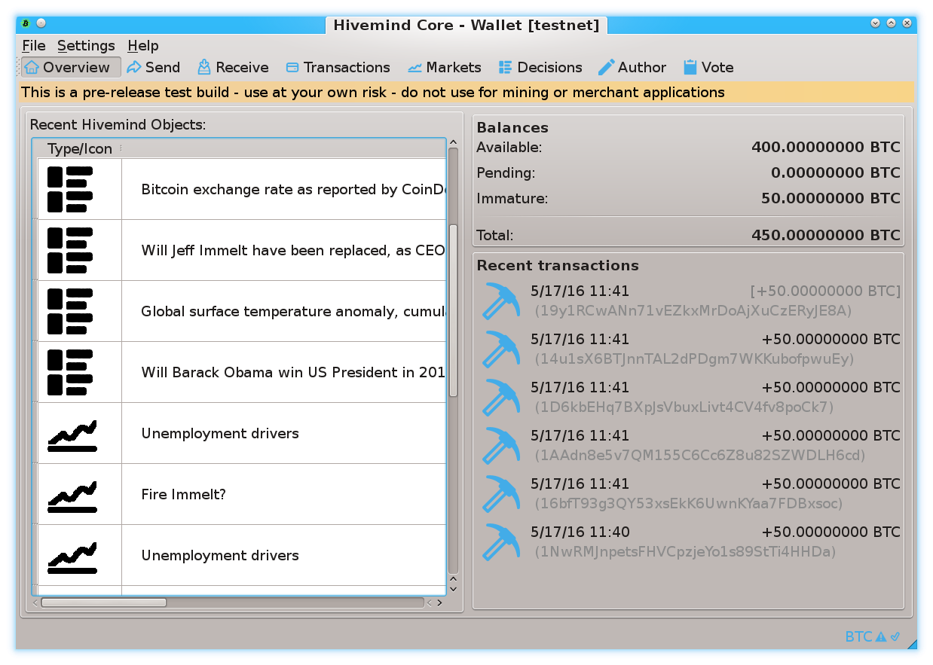
Prediction Markets
Screenshots from my own BTC sidechain project
www.BitcoinHivemind.com
Notes:
This is one of my other projects, BitcoinHivemind.com, check it out. I designed it to be a sidechain from the very beginning. Here are some screenshots…

Slide 41
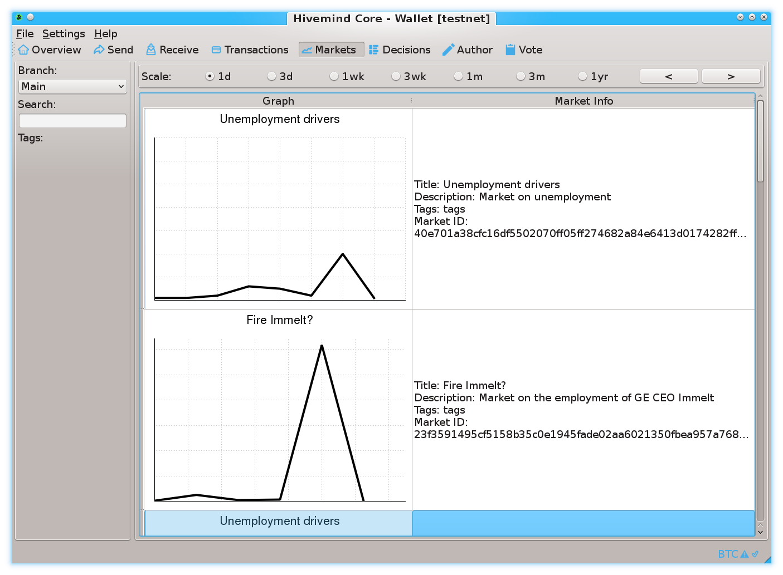
Prediction Markets
Screenshots from my own BTC sidechain project
www.BitcoinHivemind.com
Notes:
…

Slide 42
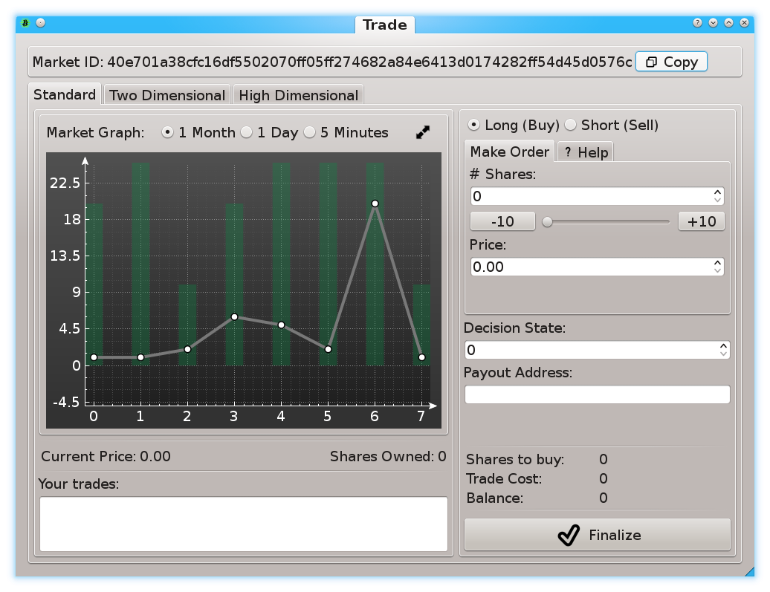
Prediction Markets
Screenshots from my own BTC sidechain project
www.BitcoinHivemind.com
Notes:
… This software can do a lot of things…

Slide 43
Prediction Markets
Screenshots from my own BTC sidechain project
www.BitcoinHivemind.com
Key Idea: “Futarchy” -- futures markets for how well certain leaders would perform, if they were in charge.
Notes:
…but the crowd favorite is ‘Futarchy’ – where there are futures markets for how well certain leaders would perform, if they were in charge. ... This idea is very distressing to bad leaders, [laugh] , because WE can learn about exactly how bad they are going to be, before we cast a vote for anyone. I think that this is one of the most important ideas in the whole world.

Slide 44
Supporters and Detractors
 | Supporters | Detractors
Theorists | Many Tech Elite ( visit LayerTwoLabs.com/friends ) | Hopelessly Confused The main concern is Billions of Revenue, may cost miners $40k , which may harm small miners. (None of that is true.)
Builders | Reluctant Altcoiners ETH, Monero, BCH, Namecoin, Sia – all created by Bitcoiners. Published comments of regret, re Bitcoin’s non-extensibility All will be cloned, by me! So we will steal back their work. | The Death Cult Unwilling to give Altcoins any credit for innovation. Or adoption. Think Bitcoin shouldn’t improve / can’t improve (since it is perfect). Prefer Bitcoin to stay niche.

Slide 45
In One Slide
More revenues ( 10x 20x ) are possible, but only if Miners educate themselves on the tech. Including conflicts-of-interest among dev groups.
What are BIPs 300/301 ?
300 allows for conversion: [ Altcoin L1 ] → [ BTC-only L2 ] .
301 allows Bitcoin miners (that’s you), to collect all the fees of these networks.
Requires 51% hashrate to activate soft fork + other very small costs.
How to get it ?
Miners take responsibility for educating self on BIPs.
Fix softfork deadlock issue. Force responsibility onto someone.
Fix Pool – Hasher communication.
Notes:
… so, by all means, go back to whatever you were doing before and don’t listen to this talk.

Slide 46
Conflicts of Interest – Time to get Woke
Devs , Users, Miners, Investors

Slide 47
Good Luck with Your Decision!
@truthcoin on twitter
@psztorc on Telegram
I know many Pools/Miners, also can contact me through them.

